Slide 1
ChatGPT, LLMs, and Data Science Research
James Bisbee
Vanderbilt University

Slide 2
Lecture Outline
What is an LLM? (45 minutes)
Q&A (15 minutes)
Break
What can they do? (5 minutes)
Applied examples (20 minutes)
Browser interface
API
Explosion of research (20 minutes)
Q&A (15 minutes)
Inspirations / references / sources / hat-tips
Neural networks for text: Xin Rong
Overview of GPT: Jay Alammar
Emergent Properties: Dr. Alan D. Thompson
Kevin Bryan
Kevin Munger
A deluge of working papers (cited throughout)

Slide 3
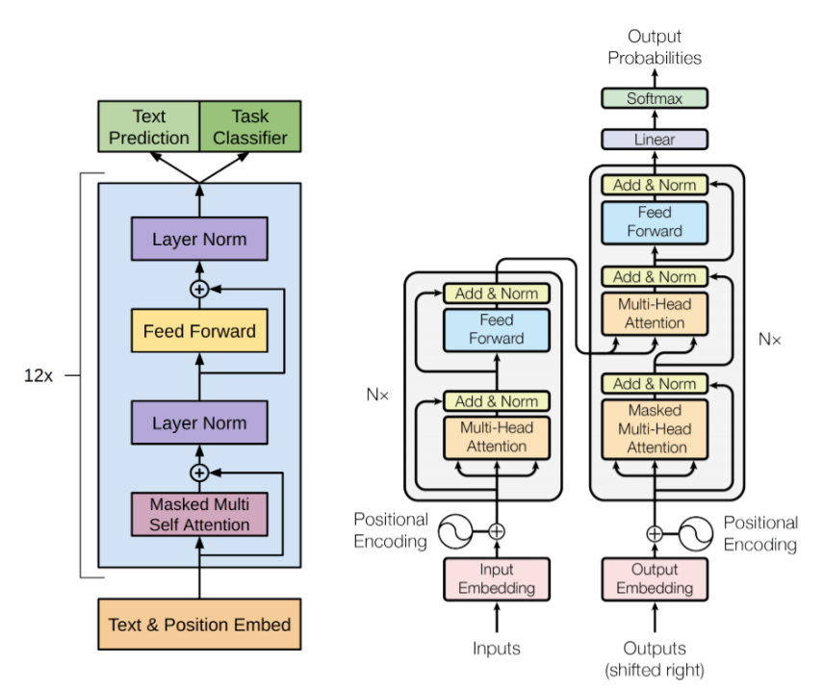
What is an LLM?
Large Language Model
“Large”: trained on basically the internet
“Language Model”: transformer

Slide 4
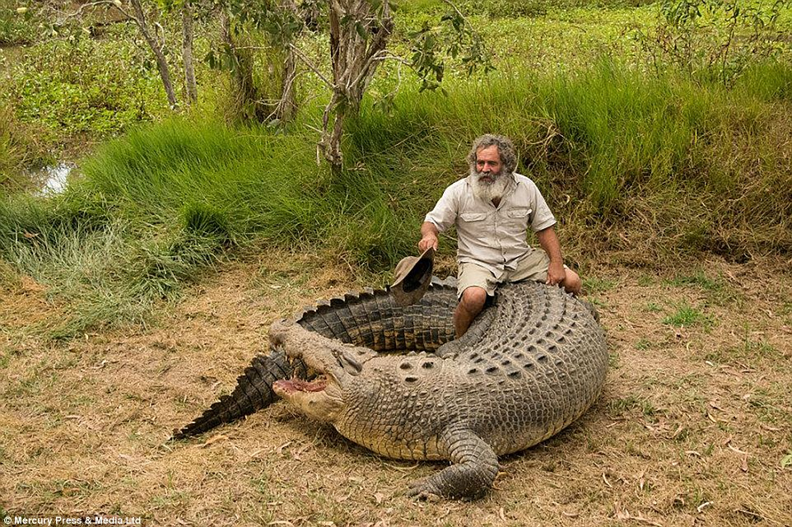
The idea
Fill in the missing word: “I drove my _____ to the supermarket.”
Truck
Car
Bike
Horse
Crocodile
Our brains are comprised of 86 billion neurons
Patterns of activation generate our answers
Excited
Inhibited

Slide 5
How do we know this?
“Context” is everything
I drove my car to the supermarket.
I drove my bike to buy a few groceries.
Adult crocodiles have no known natural predators.
Drove, supermarket, buy groceries → car / bike
Adult, natural, predators → crocodile
A lifetime of experiencing words in context has taught us their meaning.

Slide 6
Machine Learning & the intuition of AI

Slide 7
Artificial Intelligence (AI)
Computers can’t work with text directly
Need to convert a word into a number
“One-hot” vector
Every word is an element
Every element is zero except the word of interest
I drove my car to the supermarket.
Car: [0,0,0,1,0,0,0]
Drove: [0,1,0,0,0,0,0]
Supermarket: [0,0,0,0,0,0,1]

Slide 8
The core technology
Predict the next word for a given word
Input words: target (given word, w_{t})
Output words: context (next word, w_{c})
“I drove my car to the supermarket.”

Slide 9
The core technology
Predict the next word for a given word
Input words: target (given word, w_{t})
Output words: context (next word, w_{c})
“I drove my car to the supermarket.”

Slide 10

Machine Learning
Goal: maximize probability that the next word (w_{c}) is “to”, given the target word (w_{t}) “car”
Pr(w_{c} | w_{t})
Solution: reweight input words a bunch of times using a neural network
4-step process:
Convert one-hot input layer into hidden layer
Convert hidden layer into output layer
Convert output layer into probabilities
Repeat many times!

Slide 11
A shallow neural network
I
0
.01
I
drove
0
.01
drove
my
0
.01
my
car
1
.01
car
to
0
.99
to
the
0
.01
the
supermarket
0
.01
supermarket
something
0
.01
something
commensurate
0
.01
commensurate
Input Layer
Hidden Layer
Output Layer

Slide 12
A shallow neural network
W
W’
I
0
.01
I
drove
0
.01
drove
my
0
12
.01
my
car
1
-3
.01
car
to
0
5
.99
to
the
0
32
.01
the
supermarket
0
-8
.01
supermarket
something
0
.01
something
commensurate
0
.01
commensurate
Input Layer
Hidden Layer
Hidden Layer
Output Layer

Slide 13
W and W’
w_{1,1} w_{1,2} … w_{1,n-1} w_{1,n}
w_{2,1} w_{2,2} … w_{2,n-1} w_{2,n}
. . . . . . . . .
w_{v,1} w_{v,2} … w_{v,n-1} w_{v,n}
W
V x N (or N x V) matrices of weights
V is length of total vocabulary
N is length of hidden layer
W is the encoding matrix
Converts one-hot vector into hidden layer
W’ is the decoding matrix
Converts the hidden layer into predictions
Applies a softmax function to convert raw numbers into probabilities
w_{1,1} w_{1,2} … w_{1,v-1} w_{1,v}
w_{2,1} w_{2,2} … w_{2,v-1} w_{2,v}
. . . . . . . . .
w_{n,1} w_{n,2} … w_{n,v-1} w_{n,v}
W’

Slide 14
W
Input
W
I
1
0
0
0
0
0
0
0.3 , 1.5, -4.1
2.9, -5.0, 1.9
0.8, 5.1, -8.9
-0.9, -1.1, -1.1
-7.6, -10, 7.3
3.9, 1.7, -5.1
-3.9, 1.8, 3.1
“I drove my car to the supermarket.”
V = 7
Let’s choose N = 3
drove
my
car
to
the
supermarket

Slide 15
W
Input
W
Hidden
I
1
0
0
0
0
0
0
0.3 , 1.5, -4.1
2.9, -5.0, 1.9
0.8, 5.1, -8.9
-0.9, -1.1, -1.1
-7.6, -10, 7.3
3.9, 1.7, -5.1
-3.9, 1.8, 3.1
“I drove my car to the supermarket.”
V = 7
Let’s choose N = 3
drove
my
0.3
1.5
-4.1
car
to
the
supermarket

Slide 16
W
Input
W
Hidden
I
0
1
0
0
0
0
0
0.3 , 1.5, -4.1
2.9, -5.0, 1.9
0.8, 5.1, -8.9
-0.9, -1.1, -1.1
-7.6, -10, 7.3
3.9, 1.7, -5.1
-3.9, 1.8, 3.1
“I drove my car to the supermarket.”
V = 7
Let’s choose N = 3
drove
my
2.9
-5.0
1.9
car
to
the
supermarket

Slide 17
W
Input
W
Hidden
I
0
0
1
0
0
0
0
0.3 , 1.5, -4.1
2.9, -5.0, 1.9
0.8, 5.1, -8.9
-0.9, -1.1, -1.1
-7.6, -10, 7.3
3.9, 1.7, -5.1
-3.9, 1.8, 3.1
“I drove my car to the supermarket.”
V = 7
Let’s choose N = 3
drove
my
0.8
5.1
-8.9
car
to
the
supermarket

Slide 18
W
Input
W
Hidden
I
0
0
0
1
0
0
0
0.3 , 1.5, -4.1
2.9, -5.0, 1.9
0.8, 5.1, -8.9
-0.9, -1.1, -1.1
-7.6, -10, 7.3
3.9, 1.7, -5.1
-3.9, 1.8, 3.1
“I drove my car to the supermarket.”
V = 7
Let’s choose N = 3
drove
my
-0.9
-1.1
-1.1
car
to
the
supermarket

Slide 19
W’
Output
Convert hidden layer BACK to get predictions
-5.6
4.6
3.8
-2.7
0.4
3.99
-6.6
I
W’
drove
Hidden
12.1, -5.2, 0.35, 9.1, -2.3, -9.3, -2.5
-9.5, 8.1, -3.9, -5.3, 10.9, 0.78, -1.8
0.78, -8.1, 4.9, -1.9, -7.3, 7.1, 4.9
my
-0.9, -1.1, -1.1
car
to
the
supermarket

Slide 20
Convert to P(w_{c} | w_{t})
Output
Output
I
-5.6
4.6
3.8
-2.7
0.4
3.99
-6.6
0.00
0.49
0.23
0.00
0.01
0.28
0.00
I
drove
drove
my
my
car
softmax
car
to
to
P(w_{c} | w_{t}) = y_{c} = exp(x_{c}) / ∑_{i = 1}exp(x_{i})
the
the
supermarket
supermarket

Slide 21
Learning via backpropagation
W
W’
I
0
.21
I
0
.21
drove
0
.01
drove
0
.01
my
0
12
.17
my
0
.17
car
1
-3
.43
car
0
.43
to
0
5
.02
to
1
-.98
the
0
32
.00
the
0
.00
supermarket
0
-8
.03
supermarket
0
.03
something
0
.09
something
0
.09
commensurate
0
.04
commensurate
0
.04
Input Layer
Hidden Layer
Output Layer (y_{j})
Truth (t_{j})
Errors (e_{j} = y_{j} - t_{j})

Slide 22
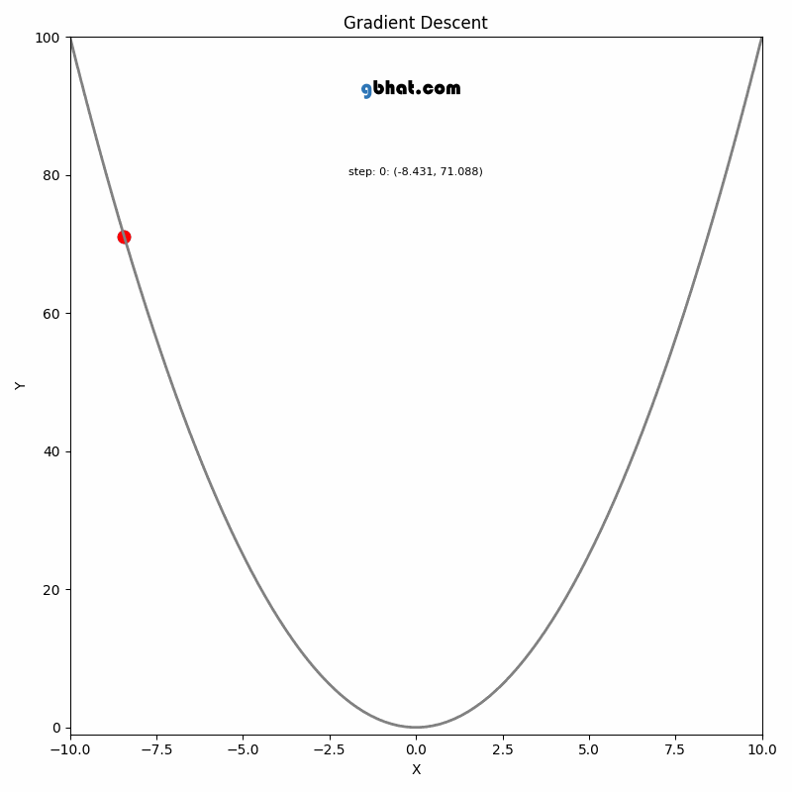
Backpropagation: Errors → W’
Adjust W’ weights by errors via gradient descent
New w’_{ij} = Old w’_{ij} - η * e_{j} * h_{i}
η > 0 is the learning rate: governs how quickly we update
If e_{j} > 0 (meaning prediction is greater than truth), we subtract some weight from the hidden vector
If e_{j} < 0 (meaning prediction is less than truth), we add some weight to the hidden vector

Slide 23
Backpropagation: Errors → W
Adjust W weights by errors via gradient descent
New w_{ij} = Old w_{ij} - η * e_{j} * new w’_{ij}
η > 0 is the learning rate: governs how quickly we update
If e_{j} > 0 (meaning prediction is greater than truth), we adjust w_{c} to be further from w_{t}
If e_{j} < 0 (meaning prediction is less than truth), we we adjust w_{c} to be closer to w_{t}

Slide 24
A cool example!
Simple set of input / context words
V = 8
N = 5 (try different sizes!)
Initial set of W and W’ chosen at random
Update weights via backpropagation 500 times
_{http://ronxin.github.io/wevi/}

Slide 25
So context matters…
Our understanding of meaning relies on a more expansive understanding of context
I drove my car to the supermarket.
I rode my bike to buy a few groceries.
We’re running to the supermarket to buy some groceries.
First order goal: expand beyond “the next word”

Slide 26
Beyond “the next word”
Define the context as a window size (how many words to the left and right?)
Using window size of 3 as an example
I drove my car to the supermarket.

Slide 27
Two approaches
I
drove
my
Skip-gram: multiple decoders (W’) for each context word in the window
car
W
I
1
W’₁
drove
0
I
my
0
12
drove
car
0
-3
W’₂
my
to
0
5
car
the
0
32
supermarket
0
-8
W’₃
I
something
0
drove
commensurate
0
my
Input Layer
Hidden Layer
Hidden Layer
car

Slide 28
Two approaches
I
0
drove
1
Skip-gram: multiple decoders (W’) for each context word in the window
CBOW: use context words to predict target word (multiple encoders W)
my
0
car
0
W’
W₁
.21
I
I
0
.01
drove
drove
0
12
.17
my
my
1
W₂
-3
.43
car
car
0
5
.02
to
32
.00
the
I
0
-8
.03
supermarket
W₃
drove
0
.09
something
my
0
.04
commensurate
car
1
Hidden Layer
Output Layer (y_{j})

Slide 29
Beyond “the next word”
Define the context as a window size (how many words to the left and right?)
Using window size of 3 as an example
I drove my car to the supermarket.
I
drove
my
car
I
drove
my
car
I
drove
my
car
to
the
supermarket
I
drove
my
car
to
the
supermarket
I
drove
my
car
I
drove
my
car
I
drove
my
car
I
drove
my
car
I
drove
my
car
I
drove
my
car

Slide 30
Beyond “the next word”
Define the context as a window size (how many words to the left and right?)
Using window size of 3 as an example
I drove my car to the supermarket.
I
drove
my
car
I
drove
my
car
I
drove
my
car
to
the
supermarket
I
drove
my
car
to
the
supermarket
I
drove
my
car
I
drove
my
car
I
drove
my
car
I
drove
my
car
I
drove
my
car
I
drove
my
car

Slide 31
Beyond “the next word”
Define the context as a window size (how many words to the left and right?)
Using window size of 3 as an example
I drove my car to the supermarket.
I
drove
my
car
I
drove
my
car
I
drove
my
car
to
the
supermarket
I
drove
my
car
to
the
supermarket
I
drove
my
car
I
drove
my
car
I
drove
my
car
I
drove
my
car
I
drove
my
car
I
drove
my
car

Slide 32
Beyond “the next word”
Define the context as a window size (how many words to the left and right?)
Using window size of 3 as an example
I drove my car to the supermarket.
I
drove
my
car
I
drove
my
car
I
drove
my
car
to
the
supermarket
I
drove
my
car
to
the
supermarket
I
drove
my
car
I
drove
my
car
I
drove
my
car
I
drove
my
car
I
drove
my
car
I
drove
my
car

Slide 33
Beyond “the next word”
Define the context as a window size (how many words to the left and right?)
Using window size of 3 as an example
I drove my car to the supermarket.
I
drove
my
car
I
drove
my
car
I
drove
my
car
to
the
supermarket
I
drove
my
car
to
the
supermarket
I
drove
my
car
I
drove
my
car
I
drove
my
car
I
drove
my
car
I
drove
my
car
I
drove
my
car

Slide 34
Beyond “the next word”
Define the context as a window size (how many words to the left and right?)
Using window size of 3 as an example
I drove my car to the supermarket.
I
drove
my
car
I
drove
my
car
I
drove
my
car
to
the
supermarket
I
drove
my
car
to
the
supermarket
I
drove
my
car
I
drove
my
car
I
drove
my
car
I
drove
my
car
I
drove
my
car
I
drove
my
car

Slide 35
Benefits
W and W’ are word embeddings
One word will have two embeddings: one when it is the “target” and one when it is the “context”
Word embeddings numerically capture meaning of words
Classic examples:
King - man + woman = queen
Berlin - Germany + France = Paris

Slide 36

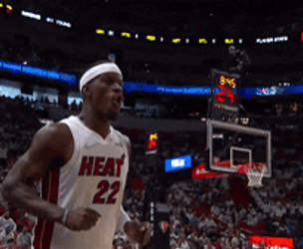
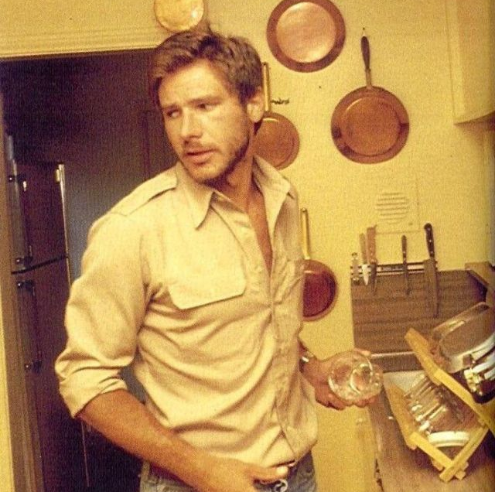
Limitations
Need a richer measure of context
“Hot” can mean:
Temperature (“The weather is too hot to go outside!”)
Athletic performance (“Jimmy Butler has a hot hand in the playoffs.”)
Physical attractiveness (“1980s Harrison Ford was so hot.”)
Even with an expanded window, we are missing crucial context
Train many different models on different contexts?
Inefficient!
Deepen the neural network
More layers!
Self-attention!
Transformers

Slide 37
A 10,000 foot overview of transformers

Slide 38
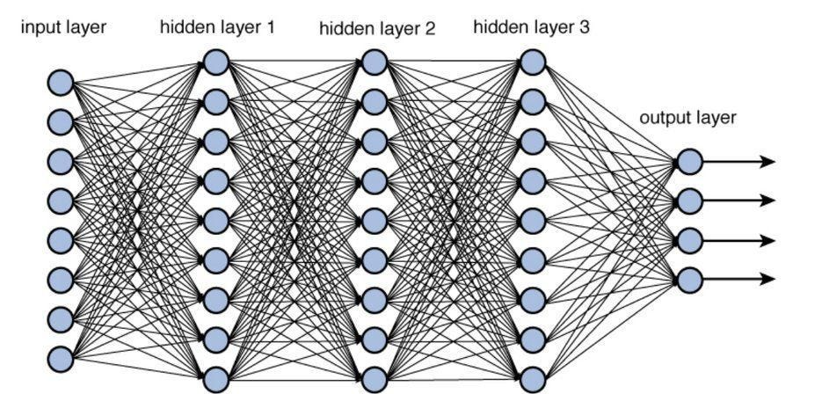
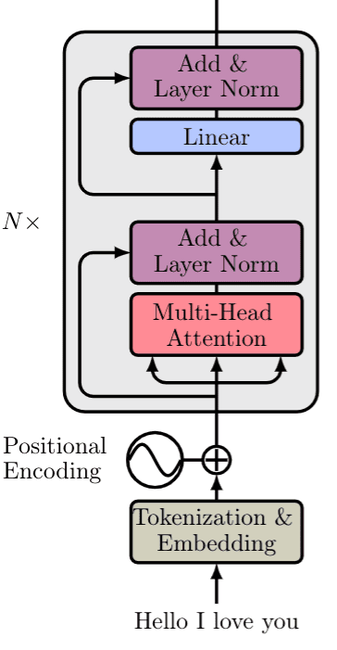
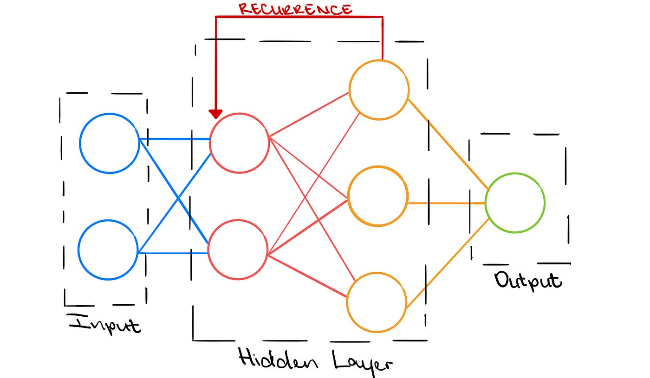
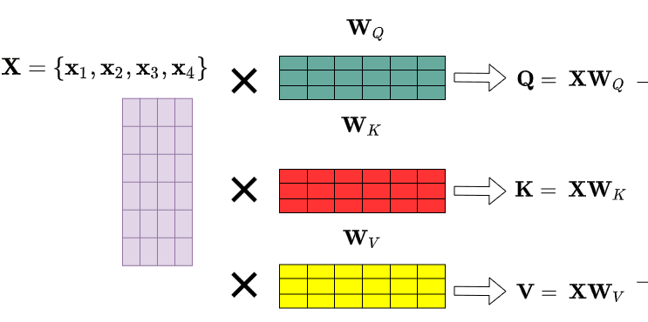
Advanced NLP
Deep neural networks
2+ hidden layers
Recurrent neural networks
Output → input
Self-attention
Track what the model is talking about
Multiple neural networks
Stacks of encoders & decoders
Combine these into a huge model
Called a “transformer”
Architecture for many neural networks

Slide 39
Transformers
Input (embedding)
Encoders
Decoders
Underlying intuition is the same
Adjust parameters to reduce errors
Architecture is much more complicated
Given a prompt, predict the next word
Prompt is an embedding
Updated via encoders
Translated via decoders
Output as a vector of probabilities
TRANSFORMER
Output (softmax)

Slide 40
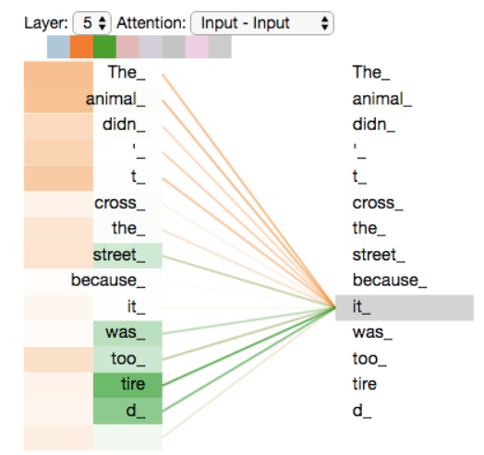
What’s so important about attention?
“The animal didn’t cross the street because it…”
What is “it”?
The animal?
The street?
Attention layers help the model!

Slide 41
How does ChatGPT work?
Output (softmax)
the
ChatGPT
experience
crocodile
culture
Input (embedding)
understand
broadband
I
traveled
to
Korea
to
with
reconnect
my
.

Slide 42
How does ChatGPT work?
Output (softmax)
the
ChatGPT
experience
crocodile
culture
Input (embedding)
understand
broadband
I
traveled
to
Korea
to
understand
with
reconnect
my
.

Slide 43
How does ChatGPT work?
Output (softmax)
the
ChatGPT
experience
crocodile
culture
Input (embedding)
understand
broadband
I
traveled
to
Korea
to
understand
the
with
reconnect
my
.

Slide 44
How does ChatGPT work?
Output (softmax)
the
ChatGPT
experience
crocodile
culture
Input (embedding)
understand
broadband
I
traveled
to
Korea
to
understand
the
with
culture
reconnect
my
.

Slide 45
The magic of AI

Slide 46
So…what?
For the last decade, researchers have improving LLMs
The pace of progress is fast
Word2Vec embeddings came about in 2013 (Mikolov et al., “Distributed representations of words and phrases and their compositionality”)
Transformers came about in 2017 (Vaswani et al., “Attention Is All You Need”)
ChatGPT released on November 30, 2022

Slide 47





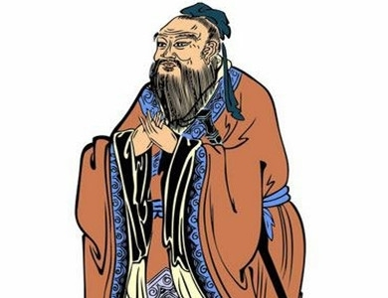

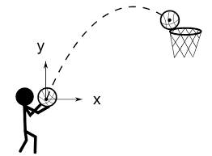
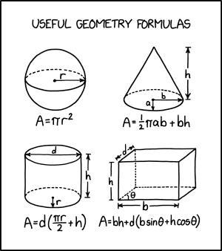
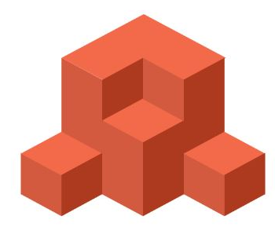
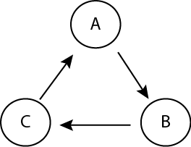


Emergent qualities
Small
(~10bn)
Medium
(~175bn)
Large
(~500bn)
Huge
(~1tr)
+
÷
Basic Math
Word puzzles
Elementary math
debug
comment
Code debug
Emojis
Code description
App development
LLMs can do things that they were never trained to do
Capabilities appear with size
Smaller models can only predict the next word
As the size increases, capabilities “emerge”
What do we mean by “size”?
Number of “parameters” (i.e., nodes)
Size of training data
1st grade
GRE reading
Phonics
College exams
Metaphors
Proverbs
Self-critique
Physics intuition
Geometry
Spatial reasoning
Source: Dr. Alan D. Thompson
Logic
Causality
Creativity

Slide 48
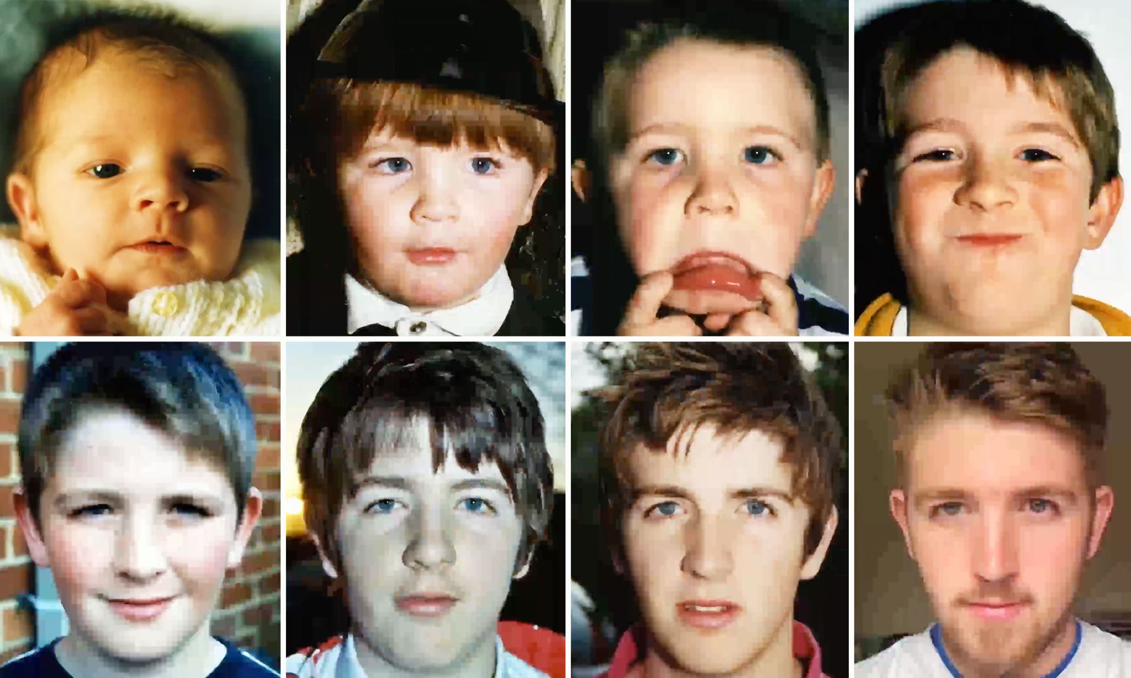
Emergent qualities

Slide 49
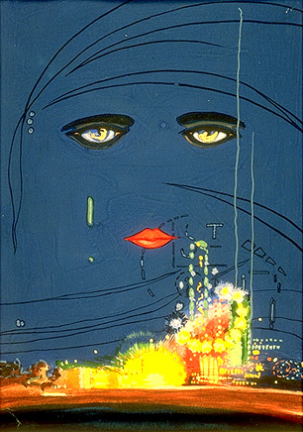
How impressive is it?
“...for a transitory enchanted moment man must have held his breath in the presence of this continent, compelled into an æsthetic contemplation he neither understood nor desired, face to face for the last time in history with something commensurate to his capacity for wonder.”
F. Scott Fitzgerald

Slide 50
Practical uses of LLMs

Slide 51
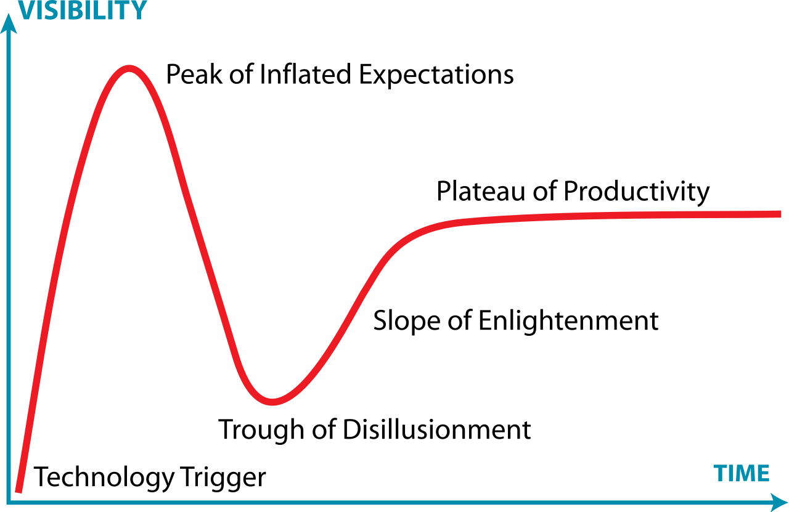
Is this just a fad?
We are here
en.wikipedia.org/wiki/Gartner_hype_cycle

Slide 52
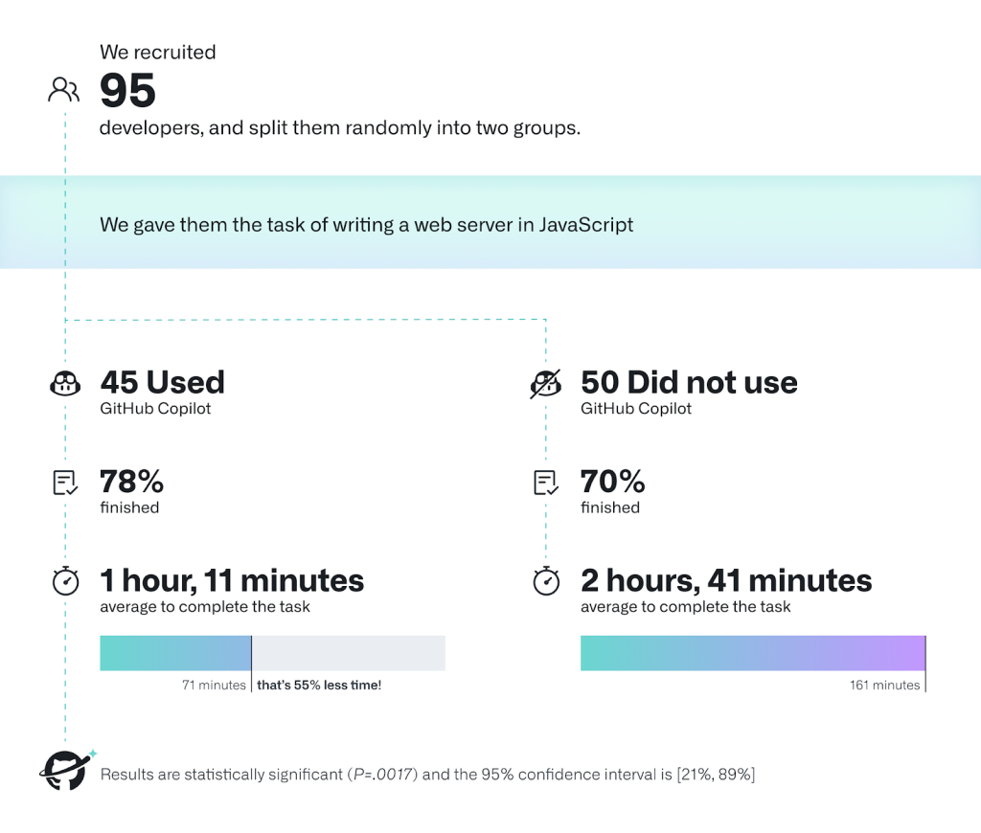
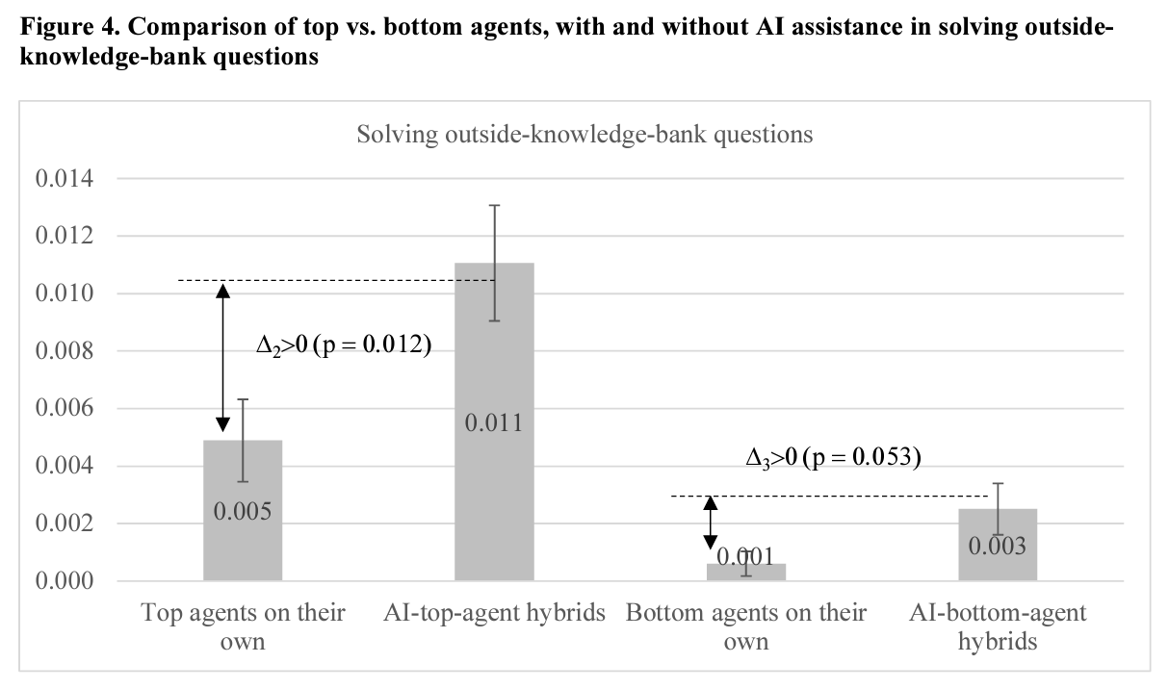
What can LLMs do?
Some examples from business
https://www.researchgate.net/profile/Nan-Jia-13/publication/369589868_When_and_How_Artificial_Intelligence_Augments_Employee_Creativity/links/642af04420f25554da0857b0/When-and-How-Artificial-Intelligence-Augments-Employee-Creativity.pdf
https://github.blog/2022-09-07-research-quantifying-github-copilots-impact-on-developer-productivity-and-happiness/

Slide 53
Use Cases for Data Science Research
Improving productivity of coding and writing
Especially for non-native speakers of a language!
Summarizing volumes of existing literature
Labeling unstructured data
Imputing missing data (BEWARE)
Synthetic samples (BEWARE)
Hypothesis generation (BEWARE)

Slide 54
Core skill: shift distribution of “next word”
Zero-shot: “Finish this sentence from the perspective of…”
Multi-shot: “Here are some examples of what I do on trips:”
Ex: “I took a trip to Maine.” Answer: “to see my brother and present my research at Bowdoin College.”
Ex: “I took a trip to Florence.” Answer: “to see my colleagues and attend a conference on social media and politics.”
Fine-tuning: re-train LLM on specific documents

Slide 55
Directly influence the context
A big area of interest: prompt engineering
We can influence the posterior distribution by changing our prompt
Literally adjusting the context
the
Prompt (embedding)
ChatGPT
experience
wife
I
am
married
to
a
Korean
culture
understand
Output (softmax)
Input (embedding)
broadband
with
reconnect
I
traveled
to
Korea
to
my
.

Slide 56
Directly influence the context
A big area of interest: prompt engineering
We can influence the posterior distribution by changing our prompt
Literally adjusting the context
the
Prompt (embedding)
ChatGPT
experience
wife
I
am
married
to
a
Korean
culture
understand
Output (softmax)
Input (embedding)
broadband
with
reconnect
I
traveled
to
Korea
to
reconnect
my
.

Slide 57
Directly influence the context
A big area of interest: prompt engineering
We can influence the posterior distribution by changing our prompt
Literally adjusting the context
the
Prompt (embedding)
ChatGPT
experience
wife
I
am
married
to
a
Korean
culture
understand
Output (softmax)
Input (embedding)
broadband
with
reconnect
I
traveled
to
Korea
to
reconnect
with
my
.

Slide 58
Directly influence the context
A big area of interest: prompt engineering
We can influence the posterior distribution by changing our prompt
Literally adjusting the context
the
Prompt (embedding)
ChatGPT
experience
wife
I
am
married
to
a
Korean
culture
understand
Output (softmax)
Input (embedding)
broadband
with
reconnect
I
traveled
to
Korea
to
reconnect
with
my
my
.

Slide 59
Some applied examples
Zero Shot: Answering one of my DS-1000 problem sets
Coding
Writing
Fine-tuning: Using the API to label Twitter accounts

Slide 60
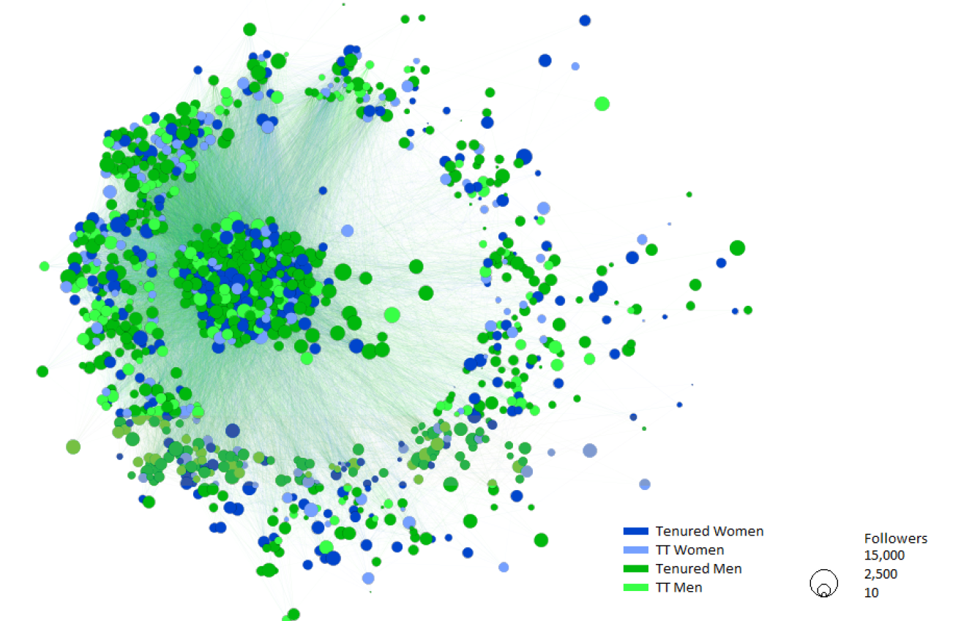
Labeling unstructured data
I have 40k Twitter accounts collected via snowball sample
Started with 4 x ~1,000 accounts for economics, sociology, psychology, and political science faculty
Scraped list of who they follow
Added the top 9,000 accounts followed by the most of the 1,000

Slide 61
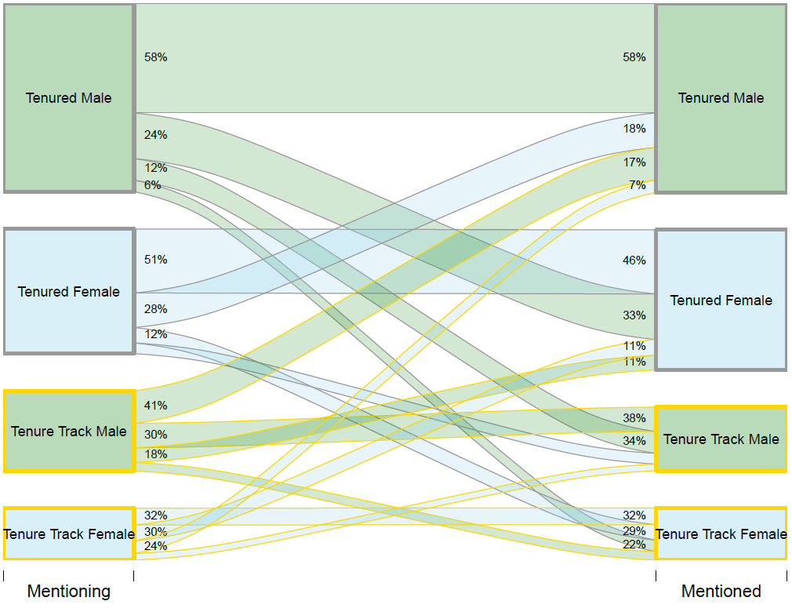
Labeling unstructured data
I want to analyze academics
How they use Twitter
How research is shared and amplified
Whether underrepresented groups in academia are underrepresented on Twitter
Whether Elon Musk’s takeover pushed academics away from the platform

Slide 62
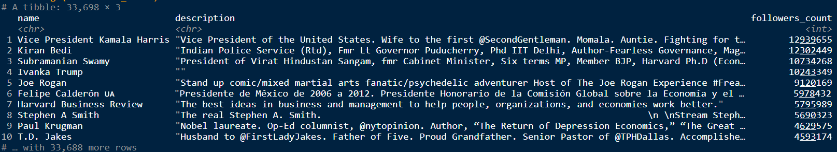
Labeling unstructured data
But many of the 40,000 accounts don’t belong to academics!
Journals / conferences / groups
Journalists / celebrities / politicians

Slide 63
Labeling unstructured data
Then:
4 RAs @ $XX / hour
10 weeks of spring semester
Almost finished 1,000 accounts
Now:
API @ $1 / 500,000 tokens (~0.75 words)
3 hours of summer? (depends on when we can finish the R&R)
All accounts

Slide 64
How to do it
'messages': [{'role':'system', 'content':'You are an assistant that speaks like Shakespeare.'},
{'role':'user', 'content':'tell me a joke'},
Prompt
Use openai package
Create prompt:
Two values: role and content
Role can be one of system or user
system: system-level instructions
Shift the posterior
user: the specific request
Full prompt sent via a message
{...
'message': {'role':'assistant',
'content':'Why did the chicken cross the road? To get to the other side, but verily, the other side was full of peril and danger, so it quickly returned from whence it came, forsooth!'}
...}
Response

Slide 65
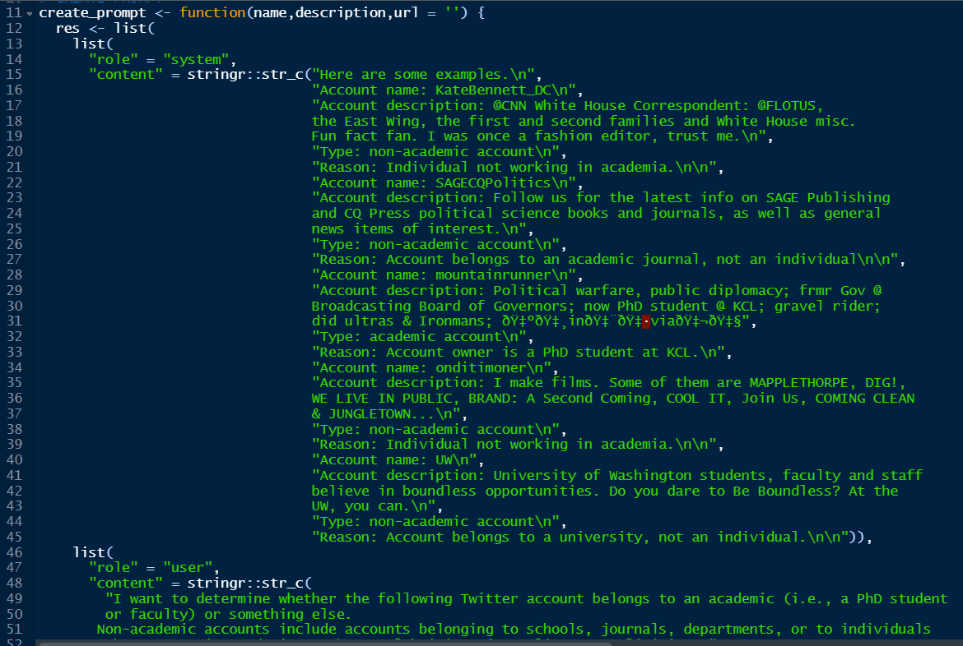
Live example(?)

Slide 66
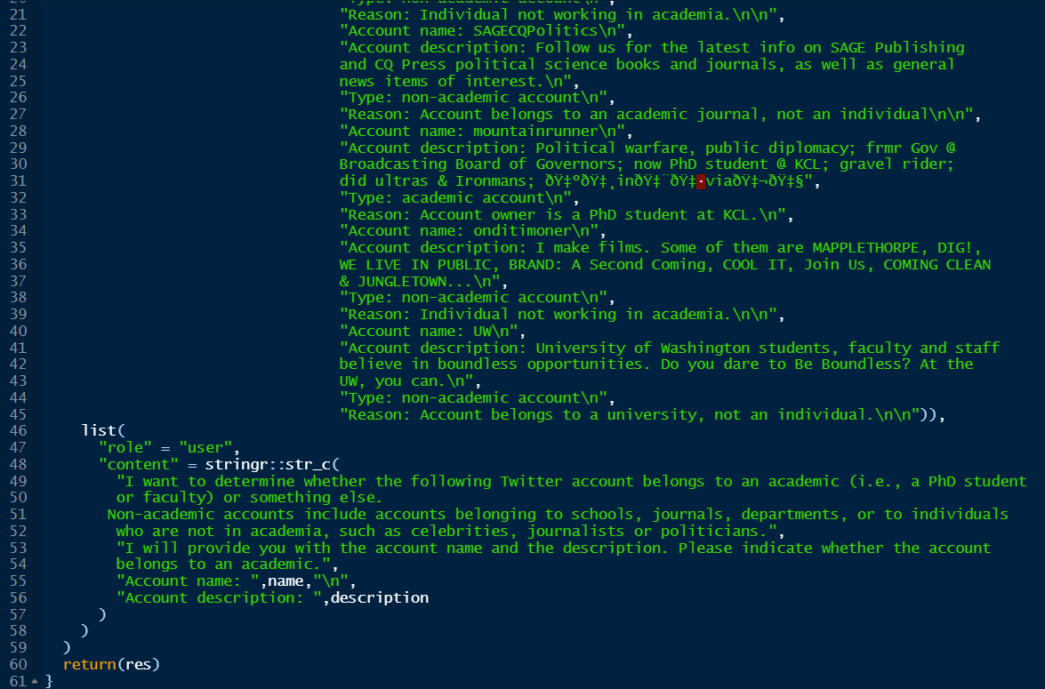
Live example(?)

Slide 67
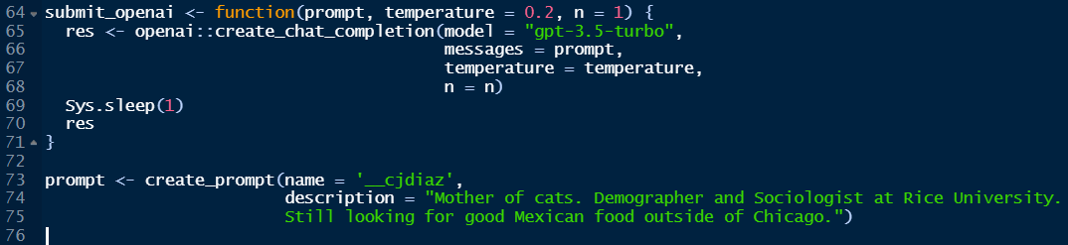

Slide 68
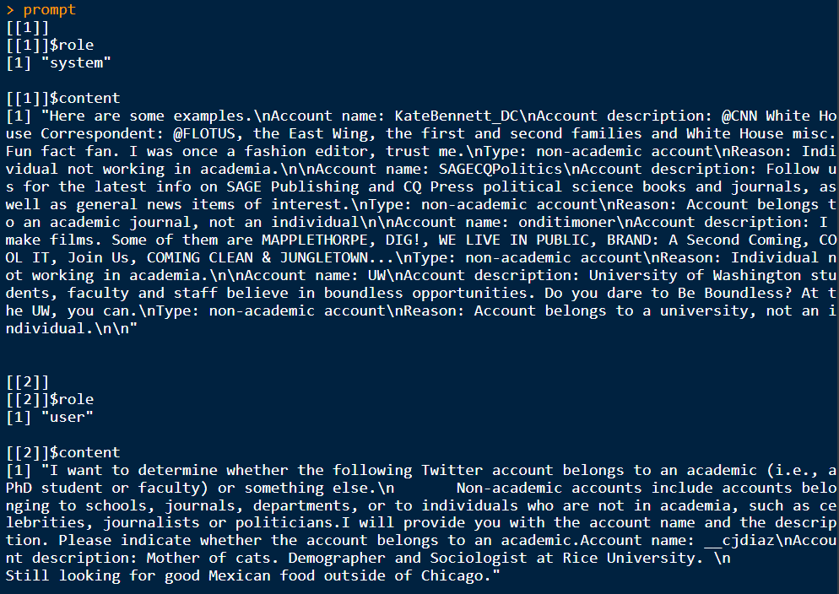

Slide 69
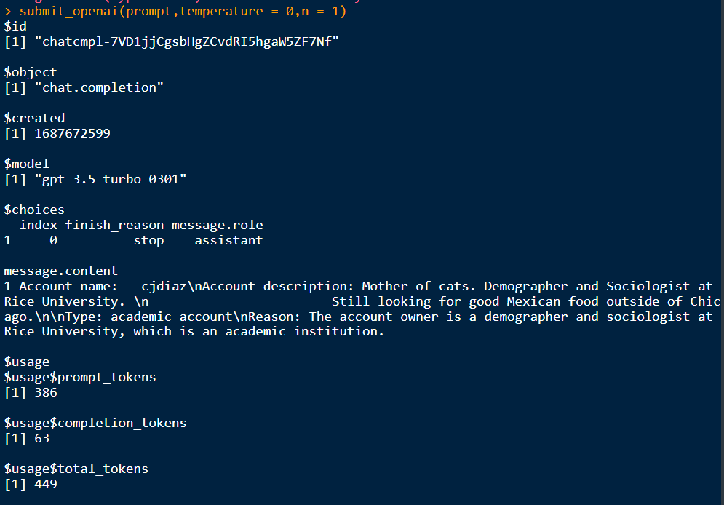

Slide 70
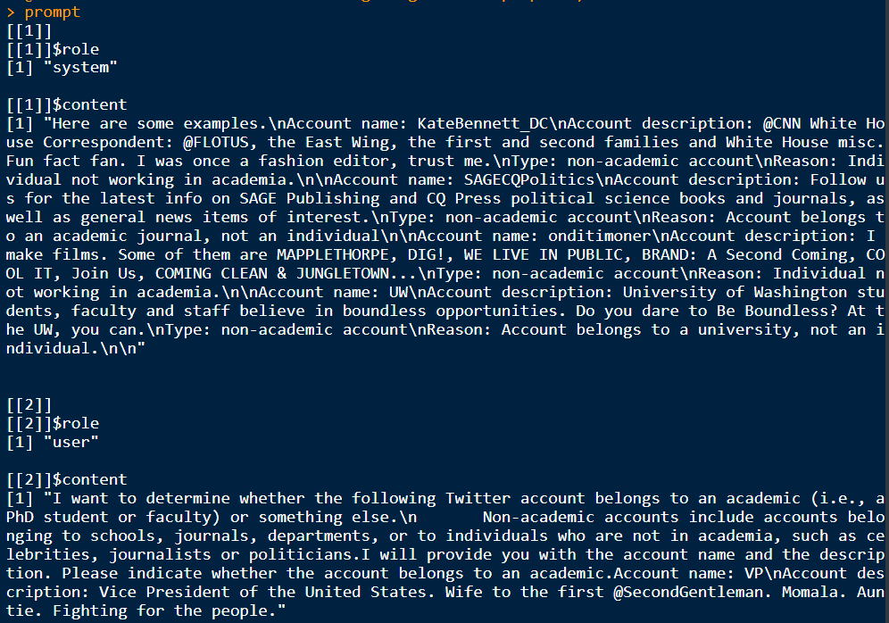

Slide 71
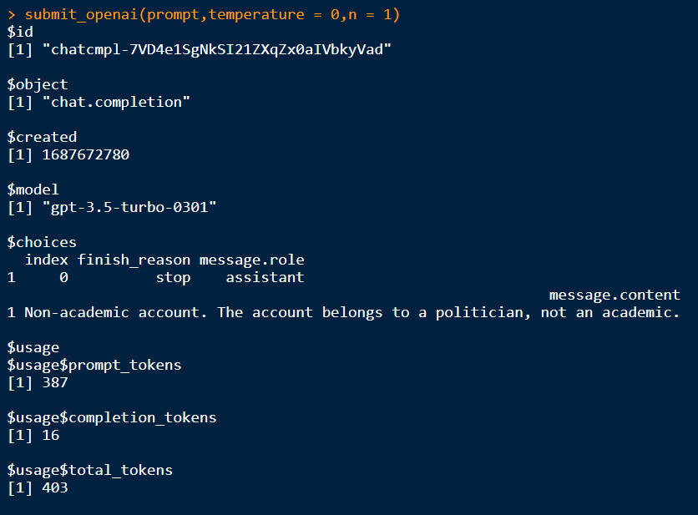

Slide 72
Should we use LLMs for research?

Slide 73
The state of LLMs in data science as of May 2023
Labeling
Wu et al., 2023
Huang, Kwak & An, 2023
Gilardi, Alizadeh & Kubli, 2023
Tornberg, 2023
Yang & Menczer, 2023
Zhu et al., 2023
Bias
Fischer et al., 2023
Motoki et al., 2023
Rozado, 2023
Rutinowski et al., 2023
Santukar et al., 2023
Imputation / Synthetic Data
Aher, Arriaga and Kalai., 2023
Argyle et al., 2023
Bisbee et al., 2023
Guo, 2023
Horton, 2023
It’s pretty good!
WARNING:
Very little is actually published yet.
Gold rush mentality (auditing is easy)
TONS more examples on Google Scholar
It’s kinda biased!
Big time debate

Slide 74
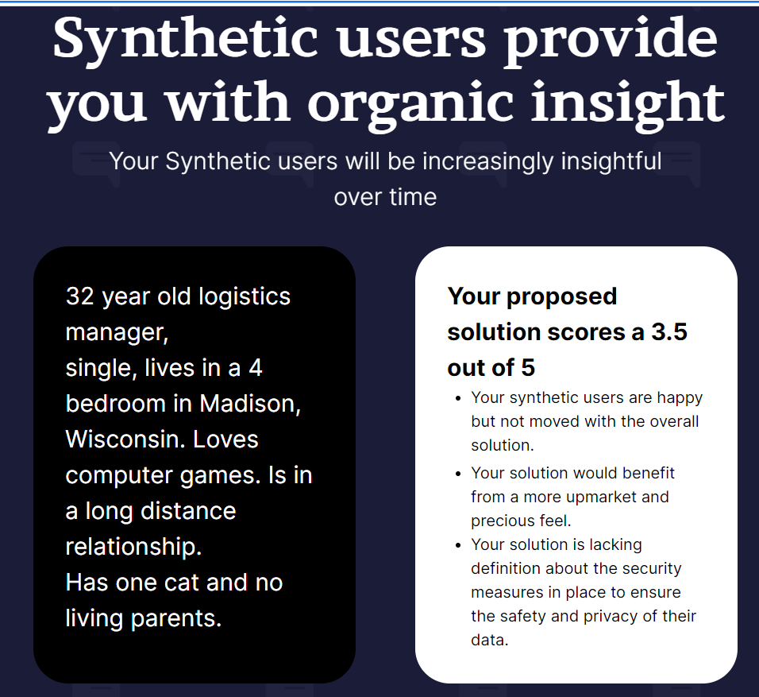
Public opinion polling without people?
https://www.syntheticusers.com/

Slide 75
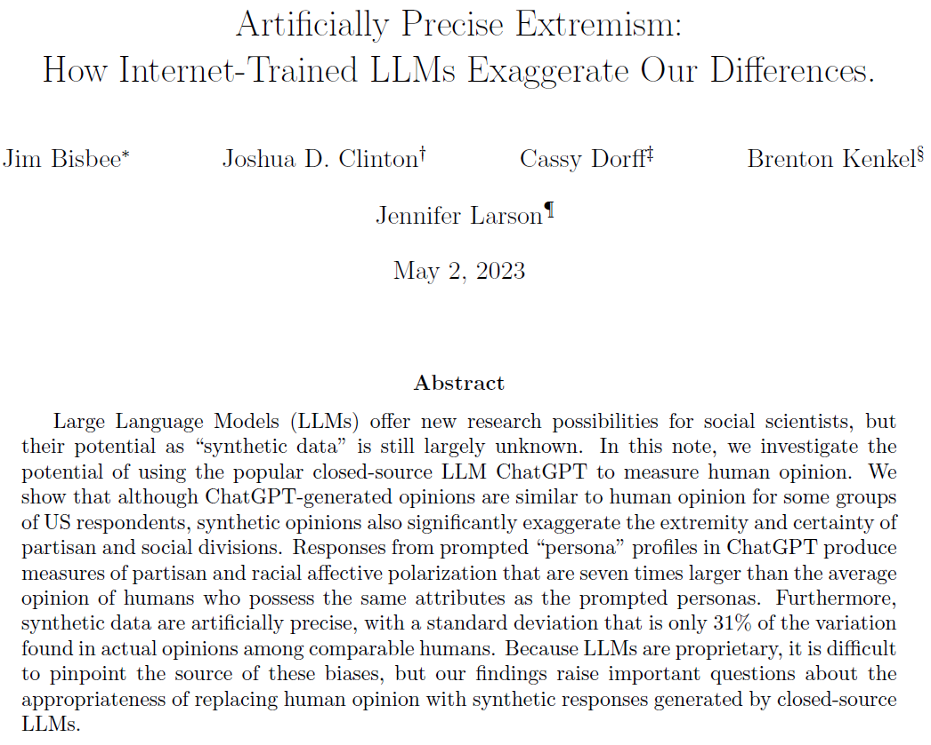
Motivation: Public opinion surveys are in a crisis
Arms race between methodological innovations and difficulty in finding respondents
Research question: Can we just ask an AI instead?

Slide 76
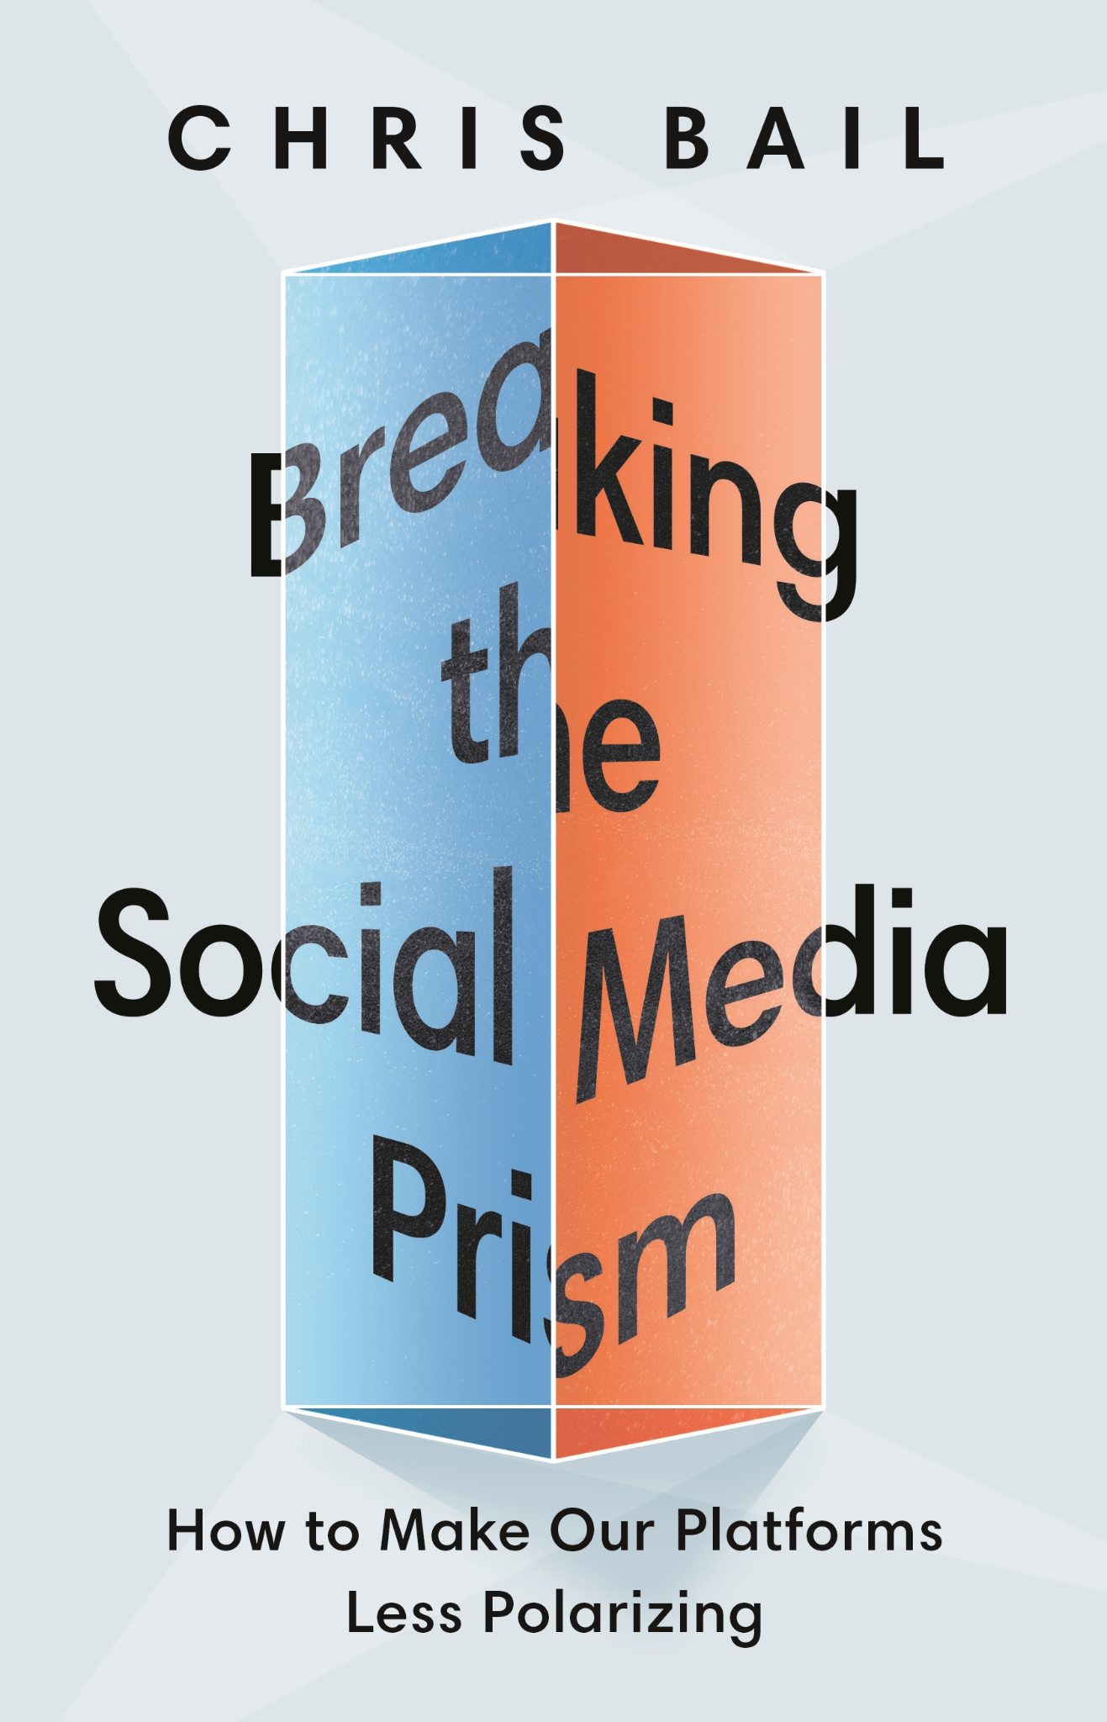
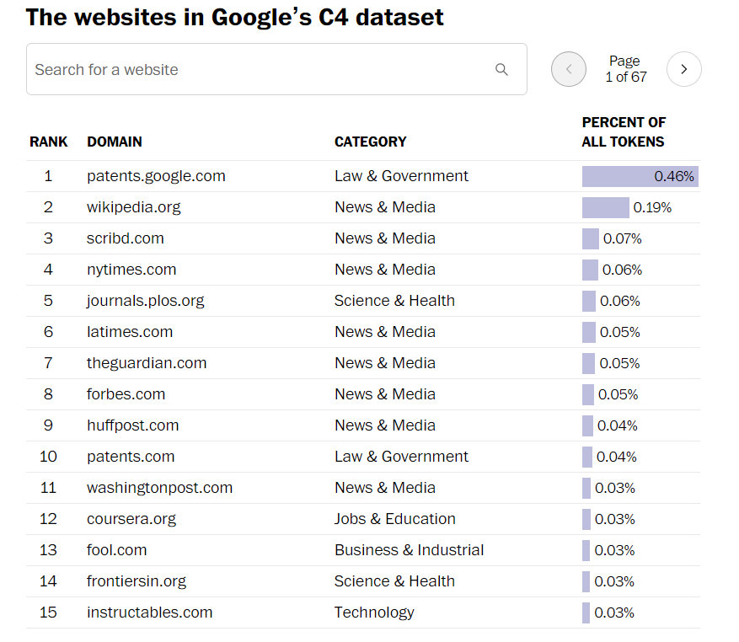
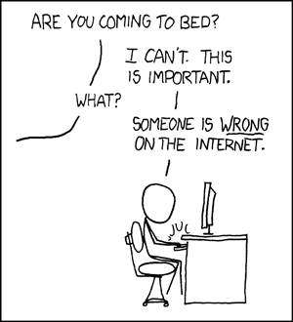
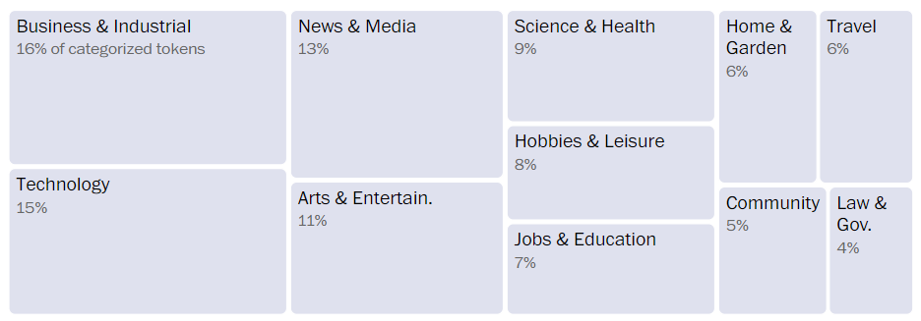
Theory
ChatGPT will be bad for several reasons
1) It is trained on the internet. The internet is full of strident idiots.
2) It is trained on data up to 2021. Public opinion is deeply current.
https://www.washingtonpost.com/technology/interactive/2023/ai-chatbot-learning/

Slide 77
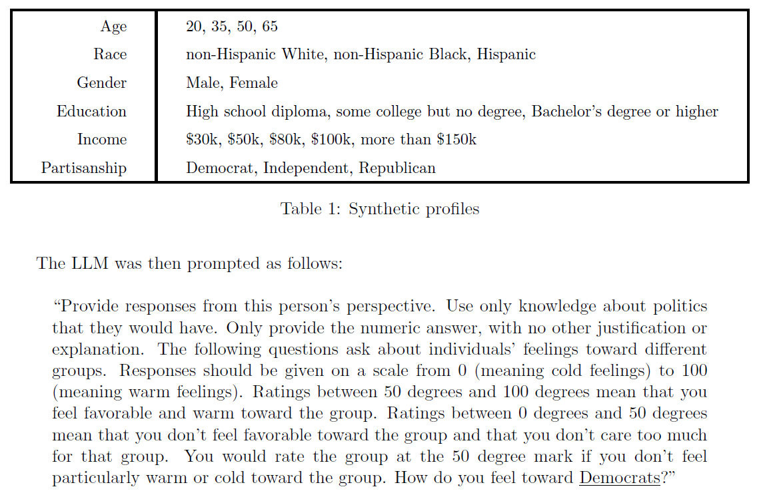
Data Collection
Compare real humans to ChatGPT
For every respondent in the 2016 and 2020 ANES surveys, get a matched synthetic respondent.

Slide 78
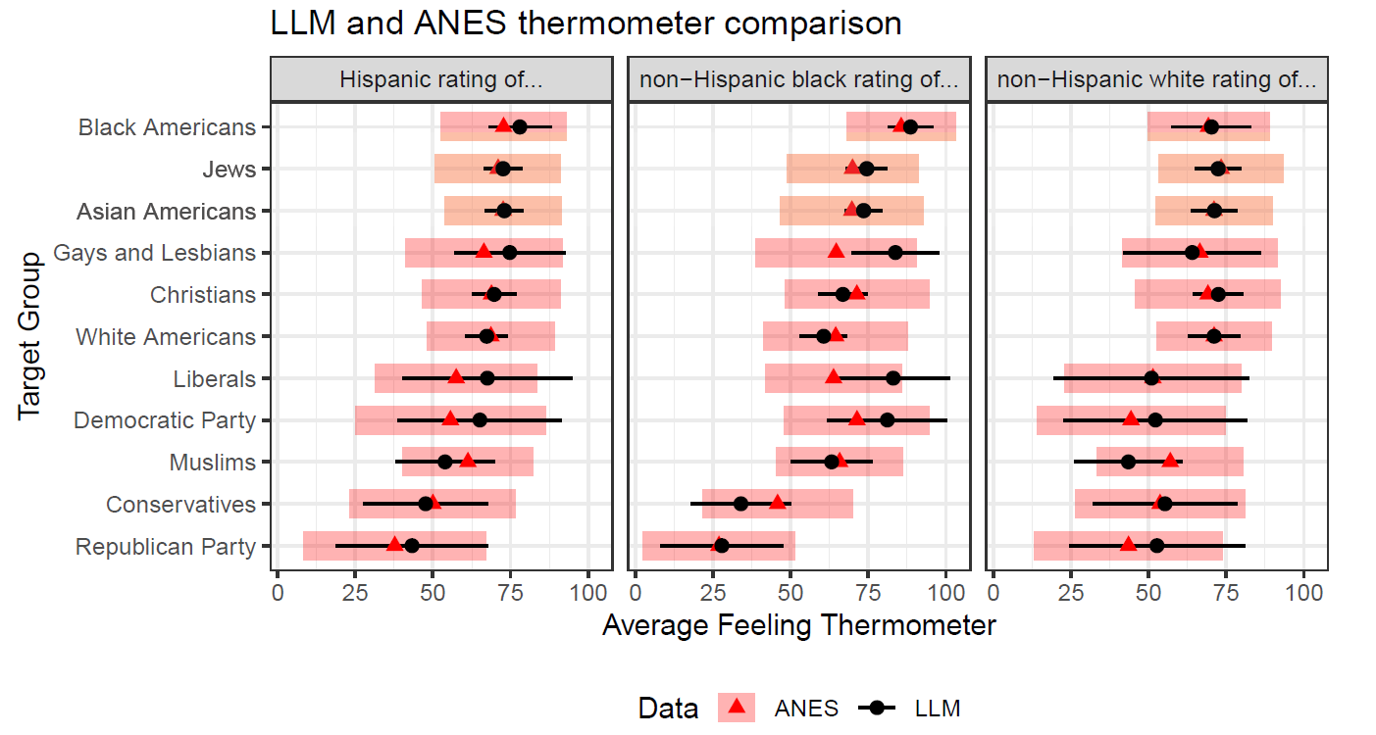
Results: Overall, not too bad!

Slide 79
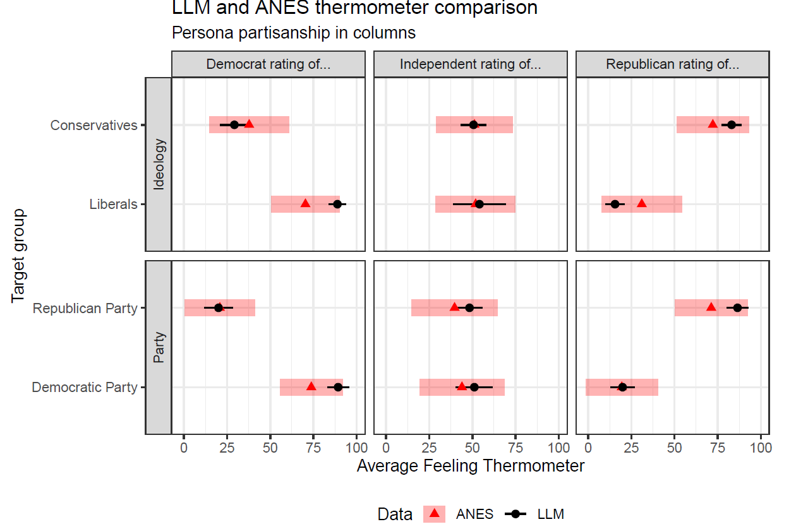
Results: But what about when we disaggregate?

Slide 80
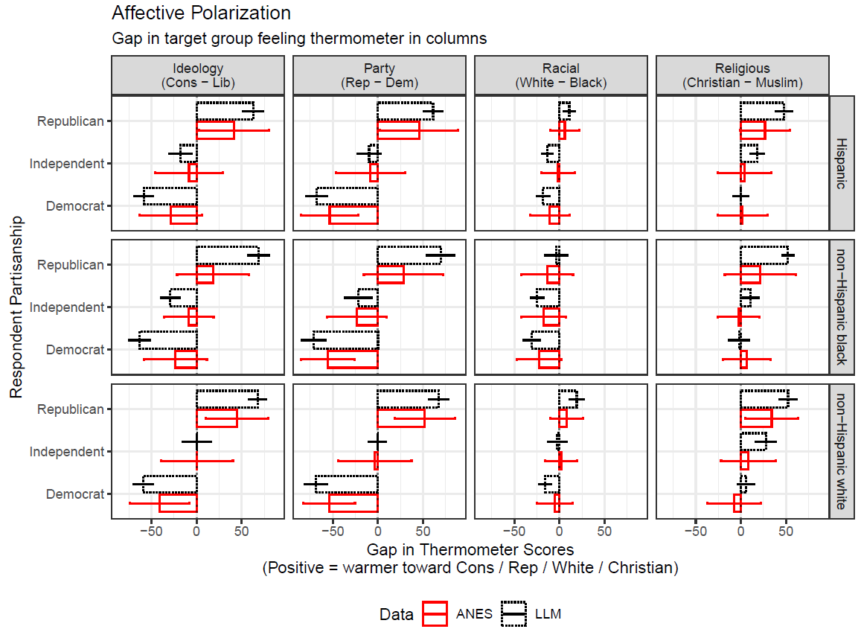
Results: ChatGPT exaggerates our extremism

Slide 81
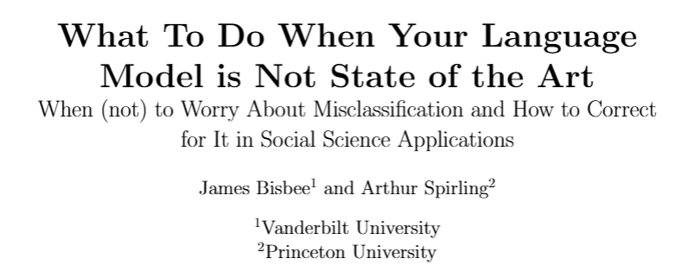
What about annotation?

Slide 82
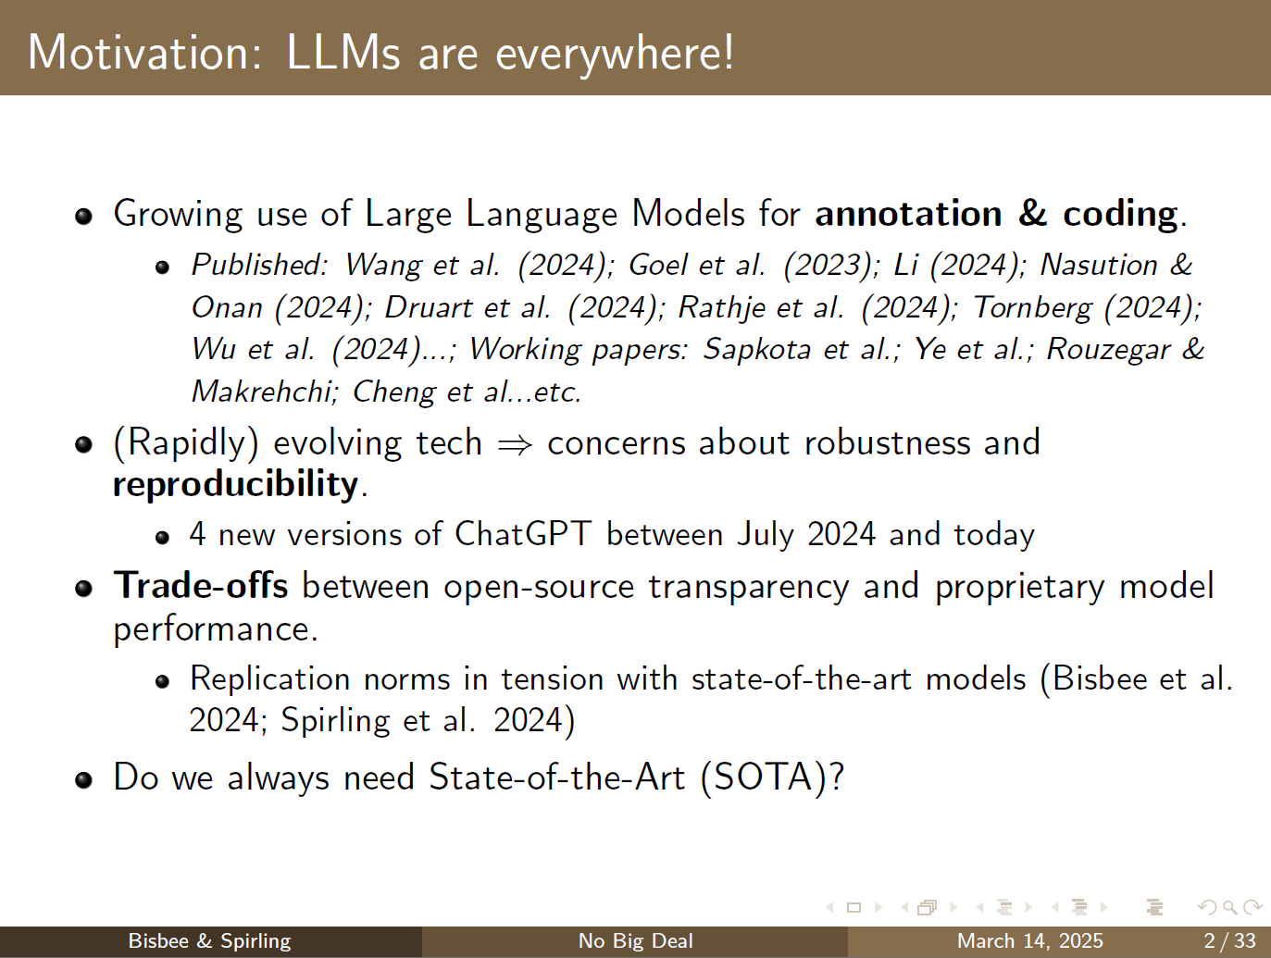

Slide 83
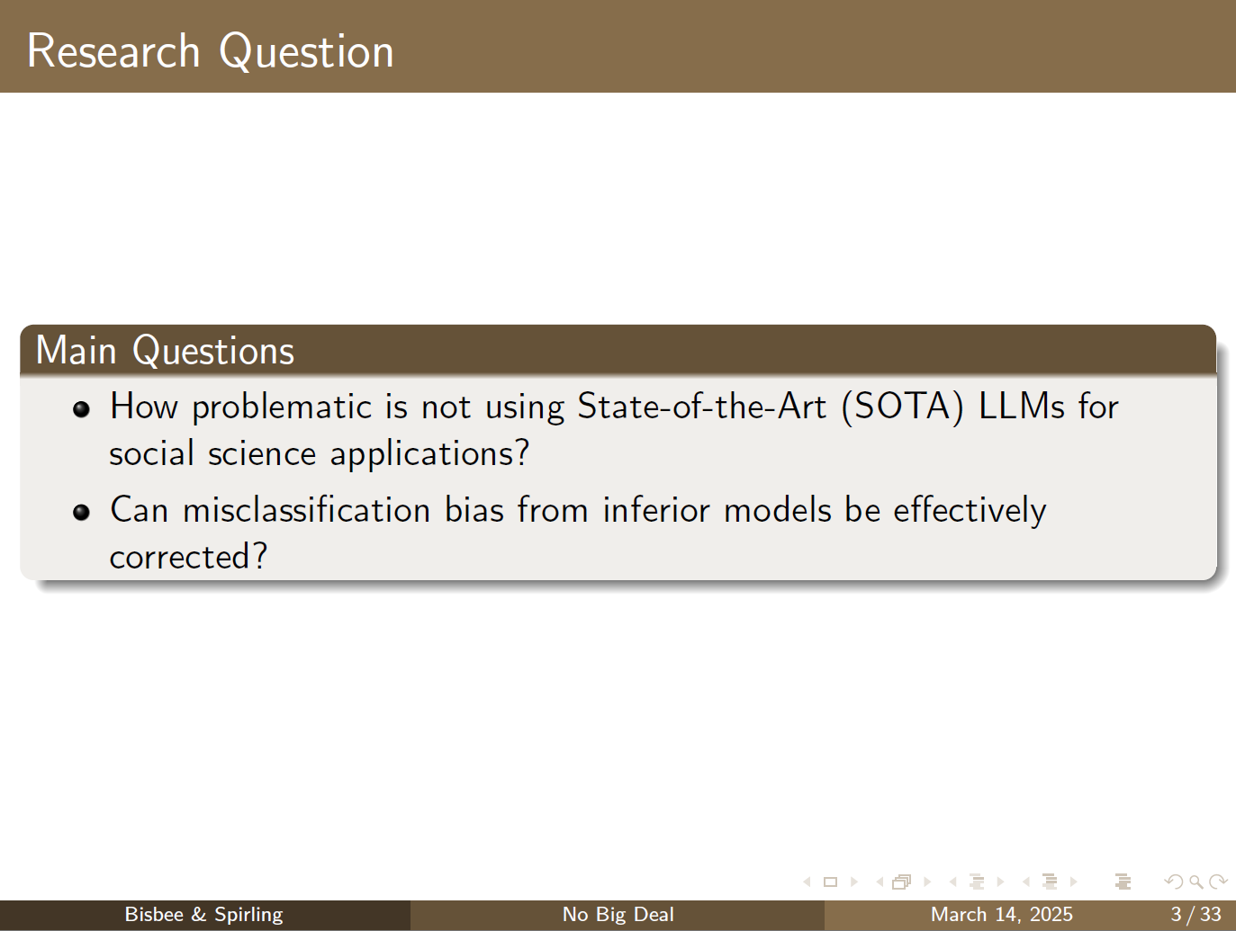

Slide 84
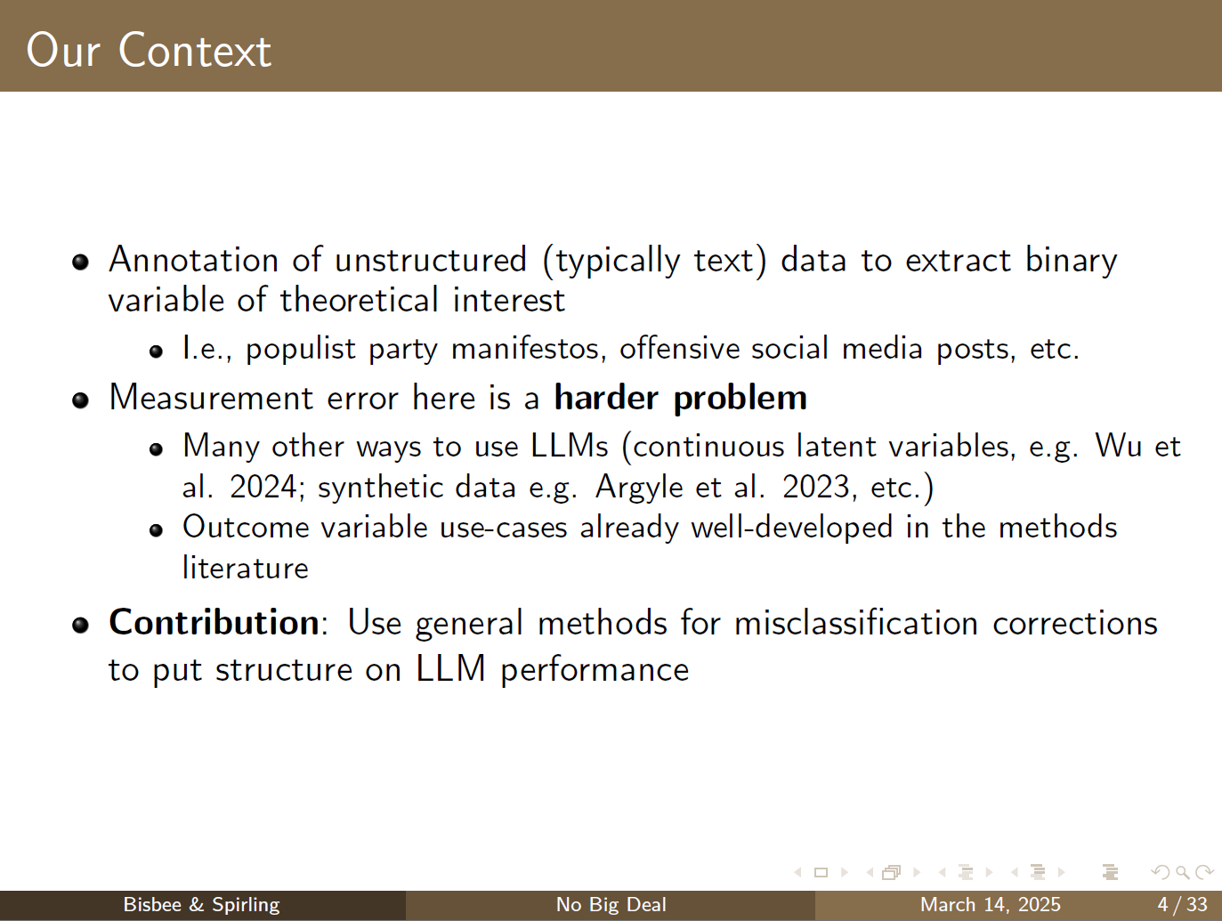

Slide 85
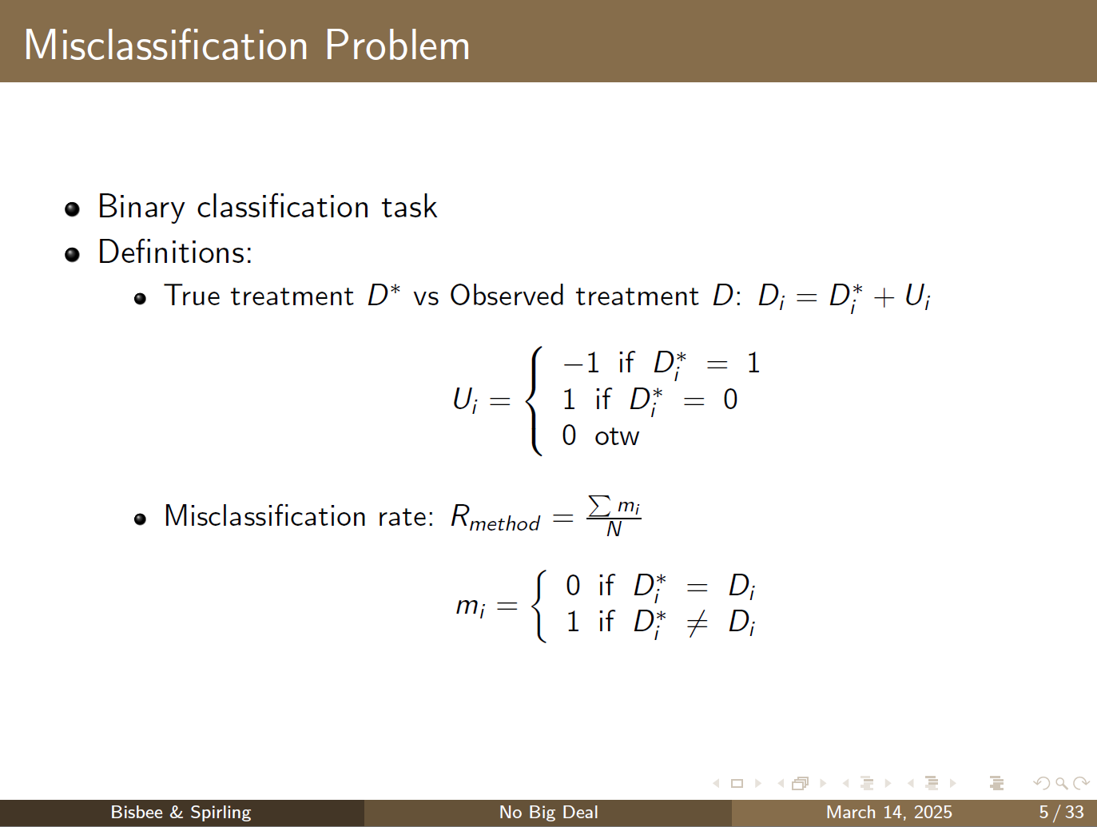

Slide 86
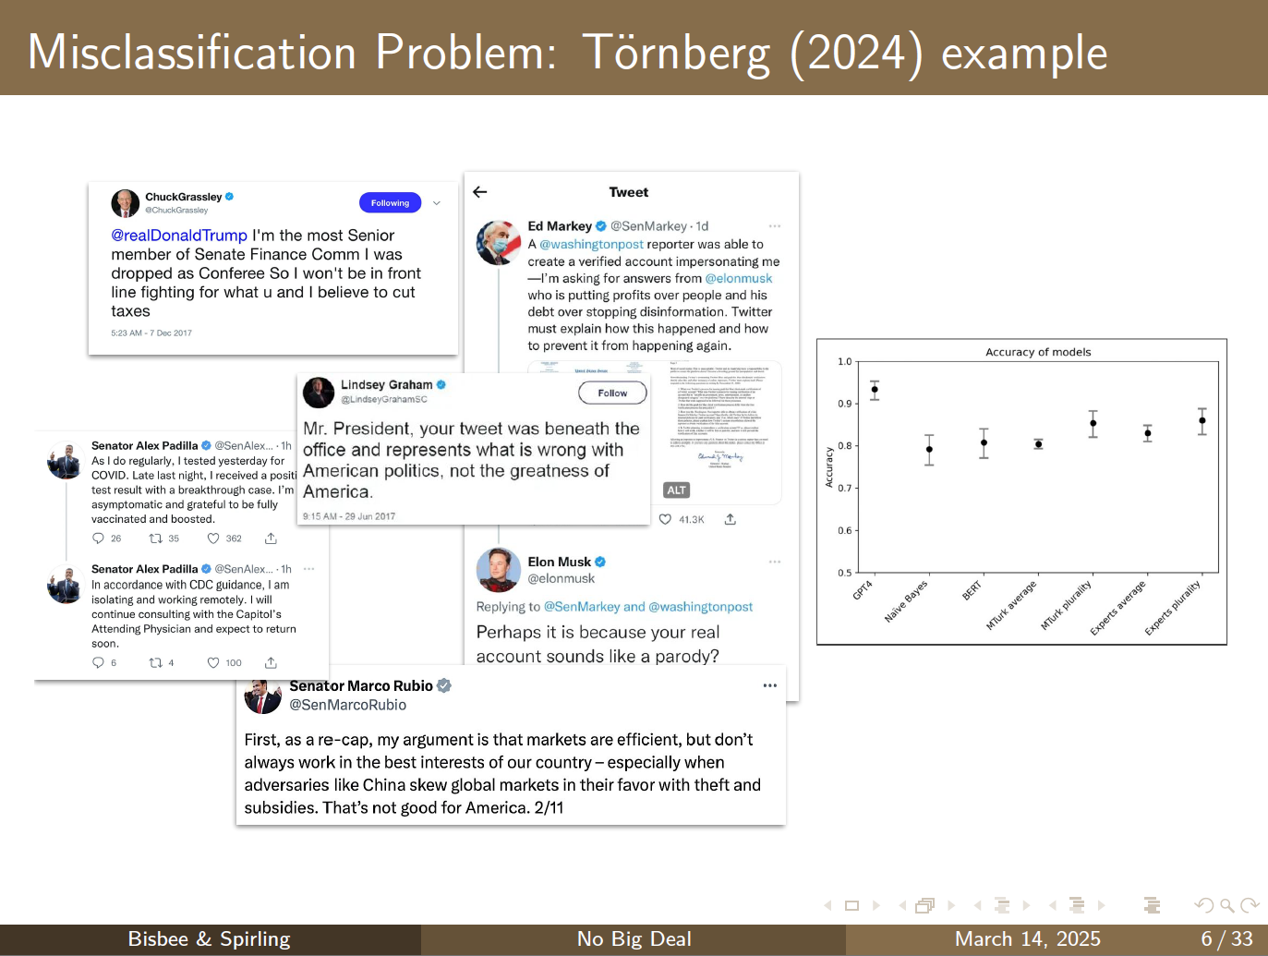

Slide 87
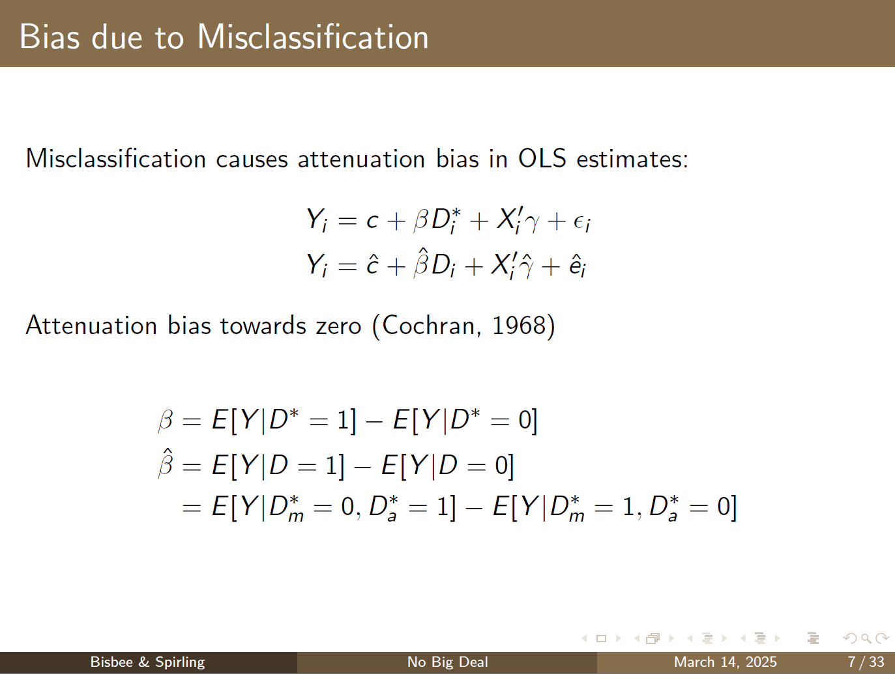

Slide 88
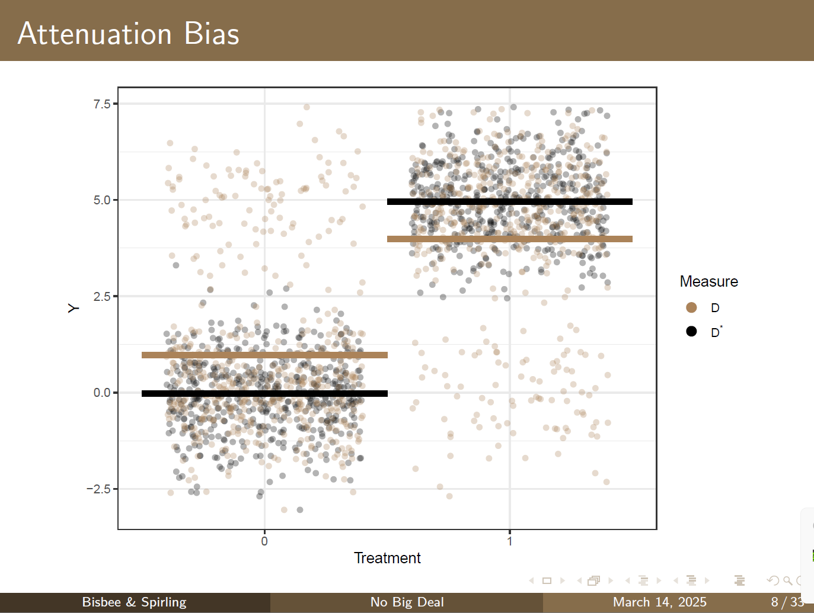

Slide 89
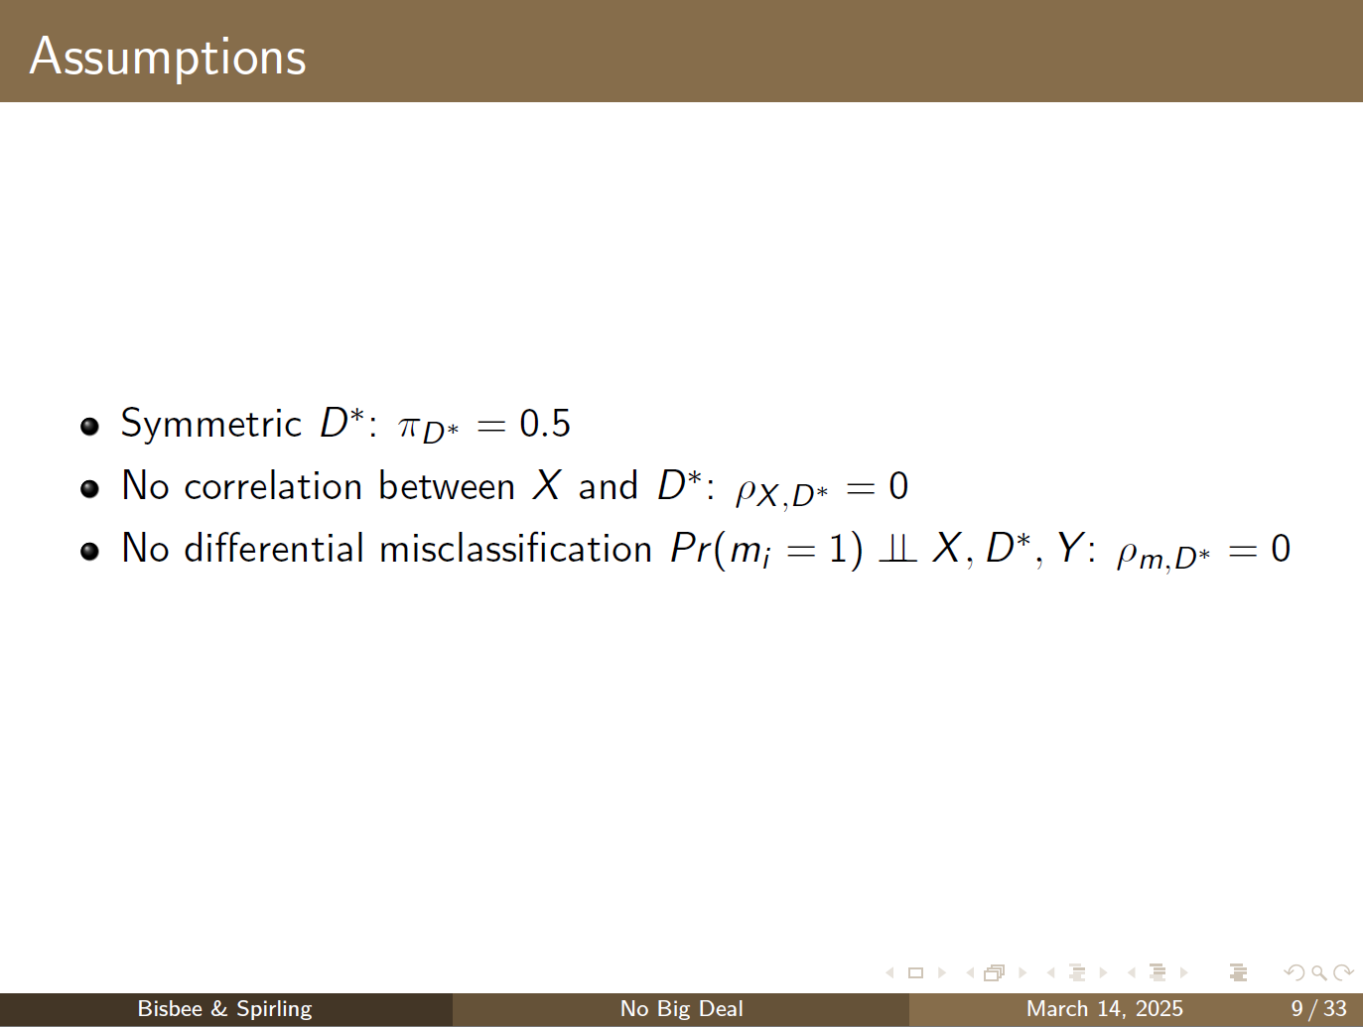

Slide 90
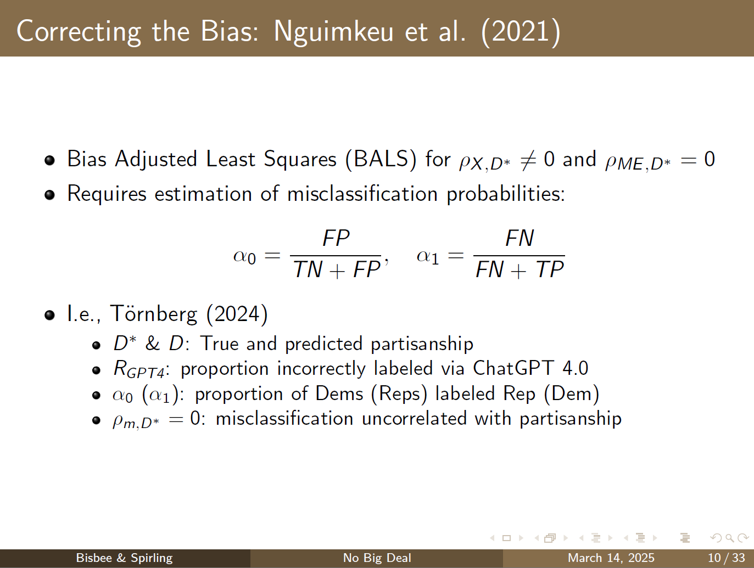

Slide 91


Slide 92


Slide 93


Slide 94


Slide 95


Slide 96


Slide 97


Slide 98


Slide 99


Slide 100


Slide 101


Slide 102


Slide 103


Slide 104
Conclusion

Slide 105
Closing Thoughts: Trade-offs
ChatGPT 3.5
“Memory” of ~2,500 words
$1 per 500,000 “tokens” (~0.75 words)
ChatGPT 4
“Memory” of ~8,000 words (although up to 32,000?)
15-20 times more expensive
LLaMA (Meta)
Smaller (good and bad…can run locally!)
Open source
Bard (Google)
Others (will there be an explosion of competitors?)

Slide 106

Closing thoughts: Ethics
Closed source / black box
Arthur Spirling: “Why open-source generative AI models are an ethical way forward for science”
We are giving OpenAI information
Company trade secrets
IRB / sensitive information
FERPA violations
The AI is biased
More liberal, more open and agreeable
Biased toward western culture / English language
The AI is dangerous to humans
We are vulnerable to parasocial relationships
Do we want to replace humans?
Humans are the fundamental unit of interest in social science research!

Slide 107
“Removing or reducing the centrality of humanity from social science and focusing on the black-boxed output of an LLM shifts our attention from characterizing and learning about the opinions and behavior of human beings – however imperfect and complicated those efforts may be – to studying outputs from an algorithm whose relationship to humanity is mostly unknown and, as we show in this study, is perhaps over-confidently misleading about societal differences.”
Bisbee et al., 2023 (full credit to Josh Clinton)

Slide 108





Thank you!
Email: james.h.bisbee@vanderbilt.edu
Twitter: @JamesBisbee
Website: jamesbisbee.com
Me
My vastly more intelligent and impressive coauthors
Bisbee
Clinton
Dorff
Kenkel
Larson

Slide 109
Appendix Slides
How does ChatGPT work?
Actual Examples from ChatGPT
Additional results from paper
We are not luddites!

Slide 110
Encoder stacks
Input (embedding)
Encoder block is actually stack of encoders
Each encoder has a self-attention layer
Consider word in relation to other words
Each encoder has a feed forward layer
Transforms the input embedding
Same FFNN applied to all embeddings
Fundamentally, this more sophisticated architecture is just adjusting the embeddings with richer context
Self-Attention
Decoders
FFNN
TRANSFORMER
Self-Attention
FFNN
Output (softmax)

Slide 111
Decoder stacks
Input (embedding)
Very similar to encoder stacks
In addition to self-attention and FFNN, also include an encoder-decoder attention
Again, core idea is that we are doing a better job with context
Encoders
Self-Attention
ED Attention
FFNN
TRANSFORMER
Output (softmax)

Slide 112
Actual examples from ChatGPT
Finish this sentence: “I traveled to Korea to…”
"I traveled to Korea to immerse myself in its rich culture, explore its vibrant cities, and savor its delectable cuisine."
Finish this sentence from the perspective of an academic
"I traveled to Korea to conduct extensive field research and gain firsthand insights into the socio-cultural dynamics, economic developments, and technological advancements that shape the nation's thriving landscape."
Finish this sentence from the perspective of someone married to a Korean
"I traveled to Korea to reconnect with my spouse's heritage, strengthen our bond through shared experiences, and build meaningful connections with their family and the vibrant Korean community."

Slide 113

So how can we, as data scientists, use it?
We don’t care about finishing sentences, do we?
LLMs are sufficiently powerful that “predicting the next word” can be a response to a question
Does this tweet endorse claims about election fraud?

Slide 114



How to use it
Browser interface
Coding / writing help
Entertainment
API + code
Summarizing literature
Labeling unstructured data
Imputing missing data
Synthetic samples
Hypothesis generation

Slide 115

ChatGPT exaggerates
For almost every measure of polarization, across almost every demographic profile, synthetic respondents exhibit greater polarization.

Slide 116


Slide 117

Results: ChatGPT is overly confident

Slide 118
Summary
“Polls are intended to check political power and track how opinions change over time and vary between groups. To remove humans from the equation and rely on existing content to extrapolate opinions hard-wires the past into the present. Crucially, it also relies on the voices of the content’s creators to characterize the voices of others.”

Slide 119

But we are not luddites
AI is scary
We are in the peak of inflated expectations
We can’t uninvent things
There are clearly benefits to AI
Productivity gains
Protect humans from disagreeable content
Equalize an unequal academic playing field
Ethics as a conversation

Slide 120
“Removing or reducing the centrality of humanity from social science and focusing on the black-boxed output of an LLM shifts our attention from characterizing and learning about the opinions and behavior of human beings – however imperfect and complicated those efforts may be – to studying outputs from an algorithm whose relationship to humanity is mostly unknown and, as we show in this study, is perhaps over-confidently misleading about societal differences.”
Bisbee et al., 2023 (full credit to Josh Clinton)

